Slide 1


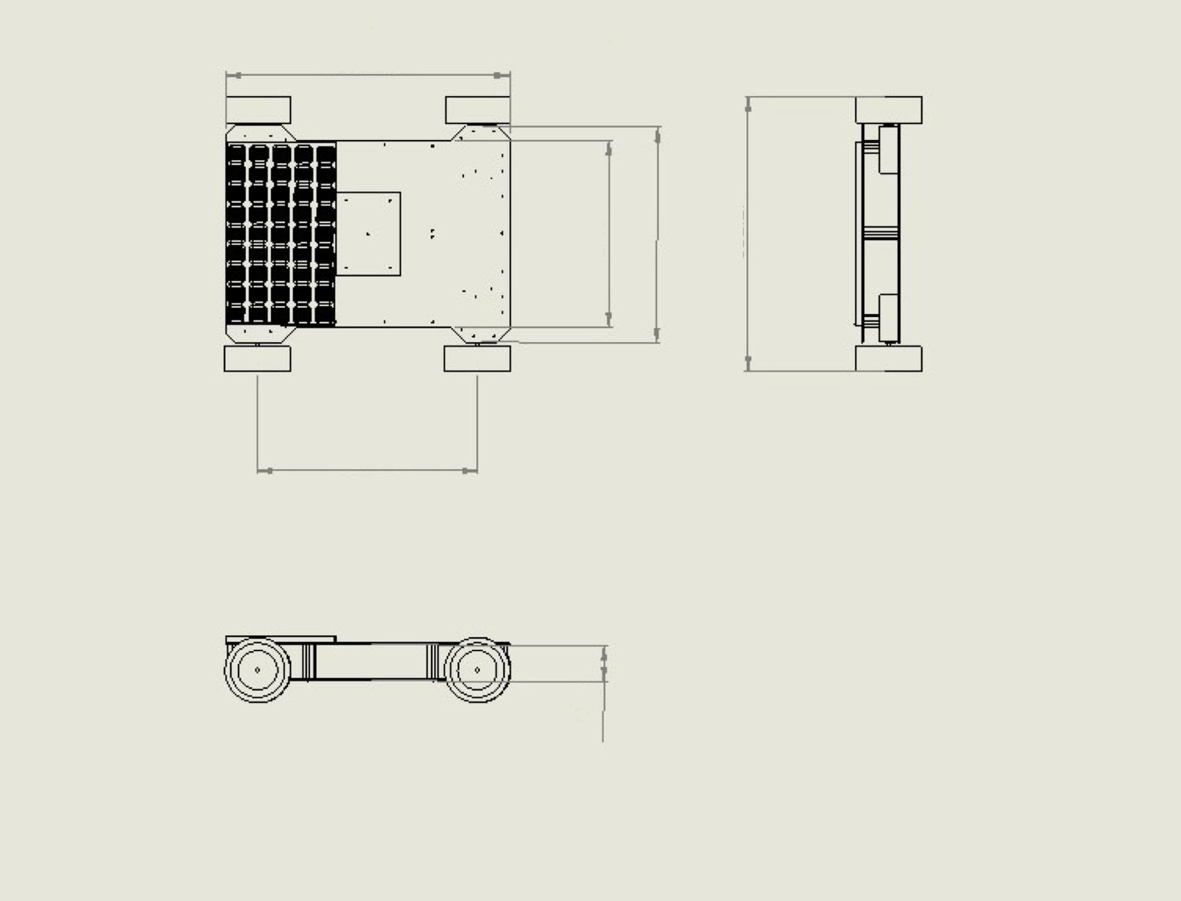
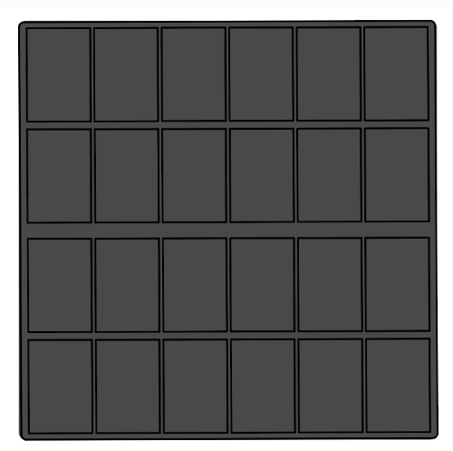
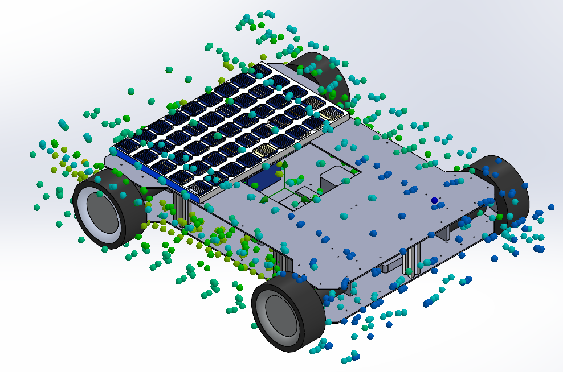
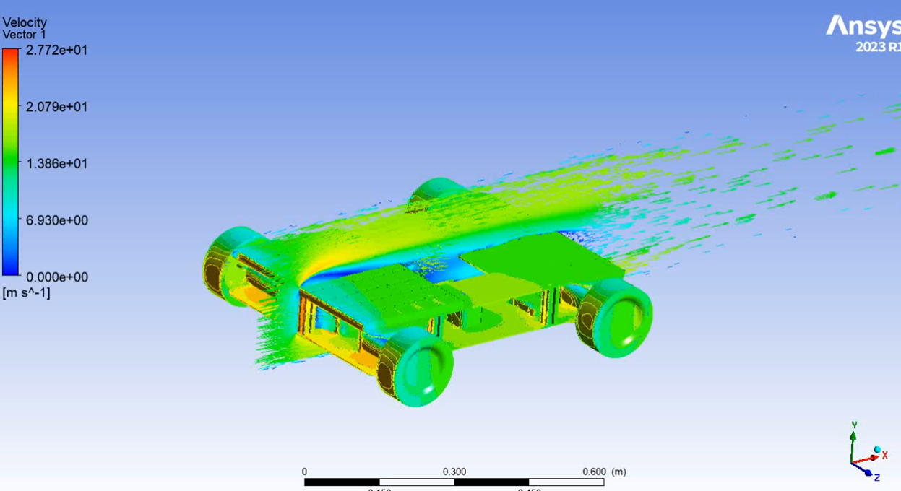
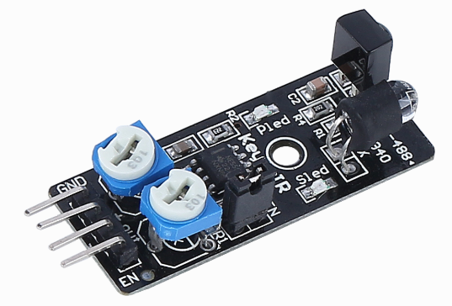
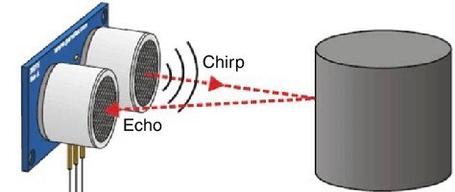
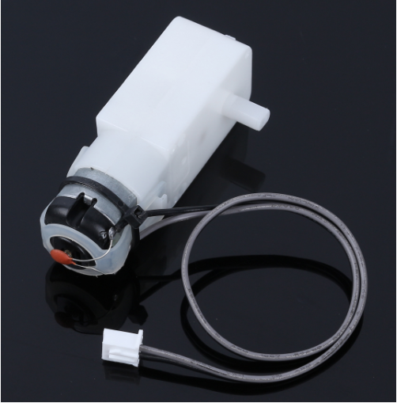
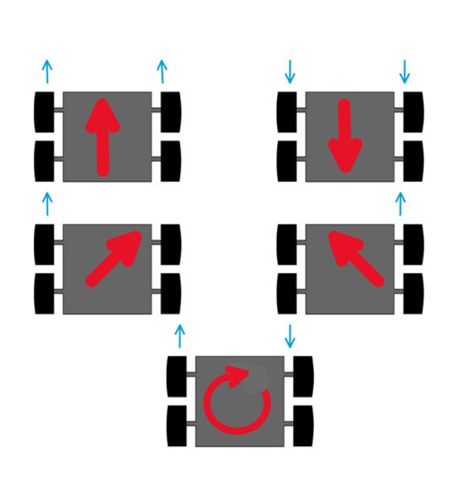
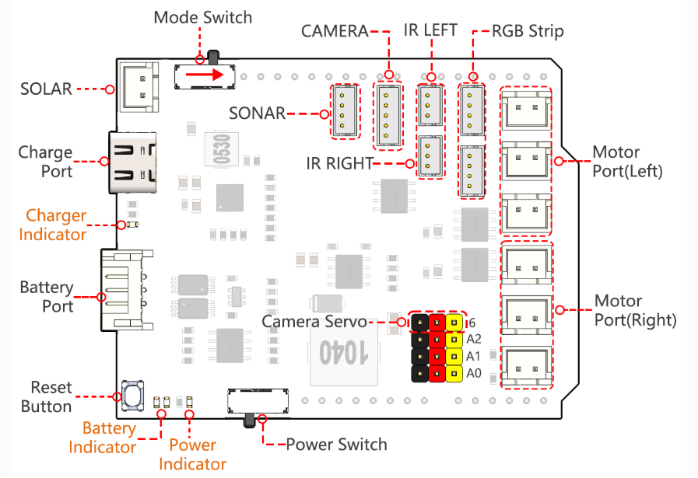
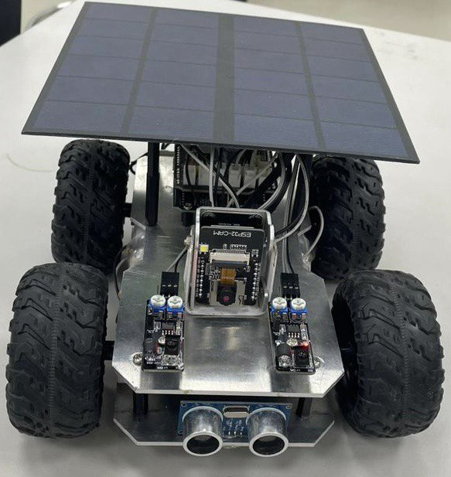
Prince Sattam bin Abdulaziz University
College of Engineering
Mechanical Engineering Department
Design and Development of Renewable Energy Actuated Car
Students: Omar Alsuhaibani , Abdulaziz Almunaysir
Supervisors: Dr. Hussein Alrobei , Dr. Rizwan Ahmed Malik
2^{sd} Semester 1446 / 2024-2025 GP 2
Introduction
Mechanical Design
Control Systems
mobile robot. of an unmanned ground vehicle (UGV) involves several key components that ensure the robot's structural integrity, mobility, and ability to interact with its environment:
Solar panels : its a devices that convert sunlight into electricity
Project Objectives
Design Dimensions:
Length: 23 cm , Width: 18 cm , Height: 11 cm
Our goal is to develop a solar-powered mobile robot for military applications such as surveillance and supply transport in remote areas. The project aims to reduce fuel dependency, enhance mission efficiency, and minimize human exposure to danger.
Sensors :
Ultrasonic : Measures distance using sound waves; ideal for accurate obstacle detection.
IR Obstacle Avoidance : Detects nearby objects using infrared light; suitable for simple obstacle avoidance.
Simulation :
An initial analysis of aero dynamics around the car was conducted using SolidWorks and Ansys Flow Simulation.
Importance of Mobile Robots
Mobile robots enhance automation in remote or dangerous areas. They improve efficiency, reduce human risk, and support continuous operation in military and industrial fields.
Robot Programming
Actuators:
DC Motors:
Connection :The code uses the ESP32-CAM library for Wi-Fi communication, enabling seamless connection to the network.
Wi-Fi Settings : Network name and password are defined for establishing a connection to the robot.
Operating Mode : The robot can switch between manual control via the app and automatic mode based on sensor inputs.
Obstacle Detection : The ultrasonic sensor stops the robot if an obstacle is detected within 20 cm.
Kinematics of Mobile Robot
Controller:
Shield : A multifunctional board that simplifies connections, manages power, and supports camera integration for smooth and efficient robot control.
Conclusion
Our project optimizes transportation by utilizing solar-powered mobile robots. The renewable energy source ensures continuous operation, reducing reliance on conventional fuel. The solar car offers an eco-friendly and sustainable solution for modern transportation, minimizing environmental impact and operational costs.

