Slide 1


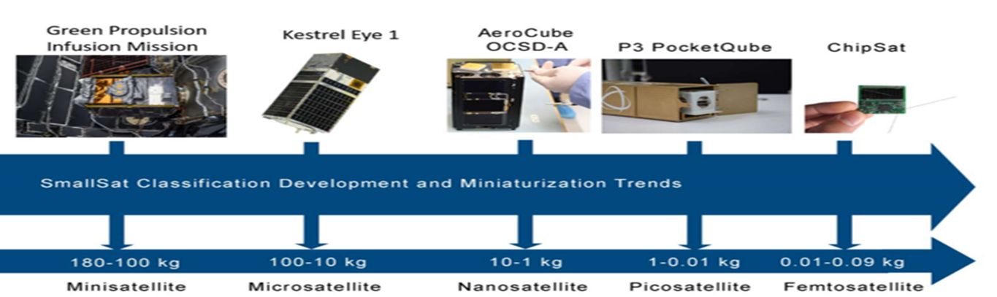
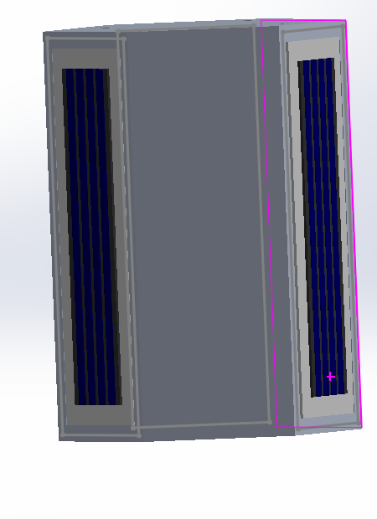

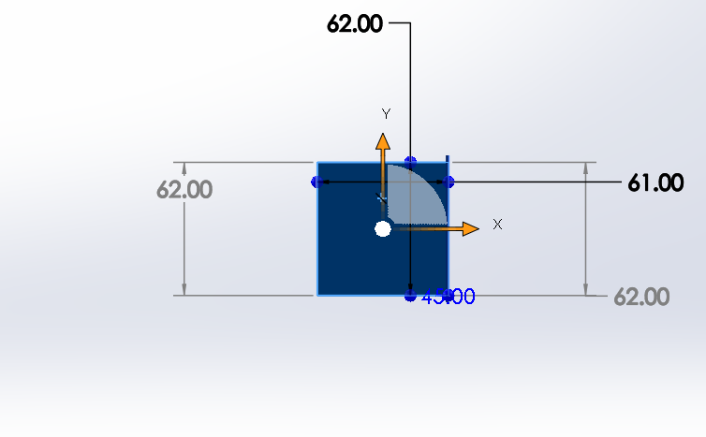
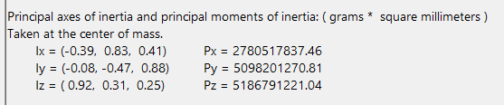
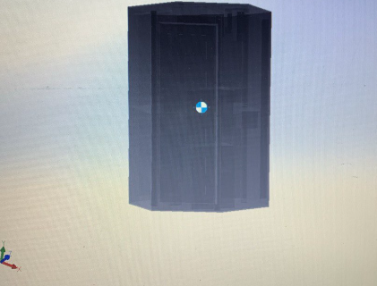
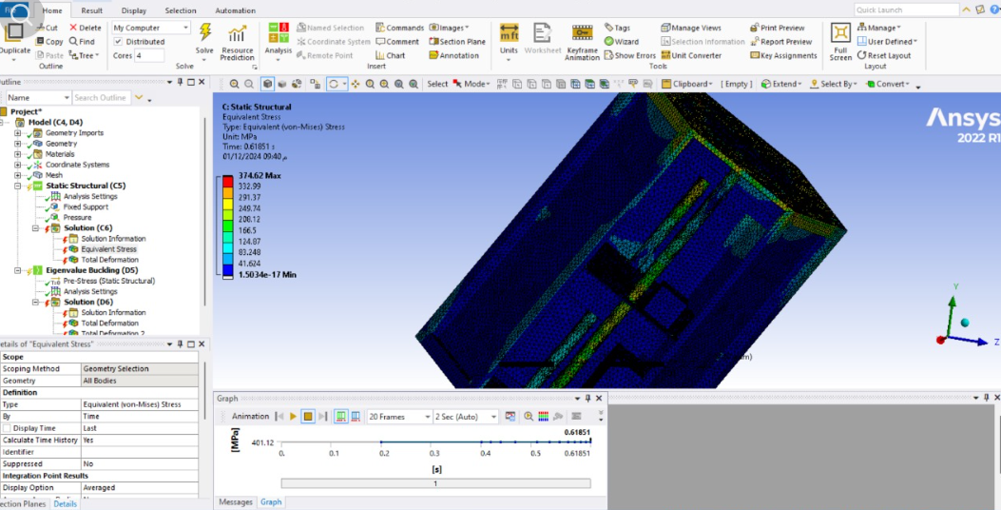
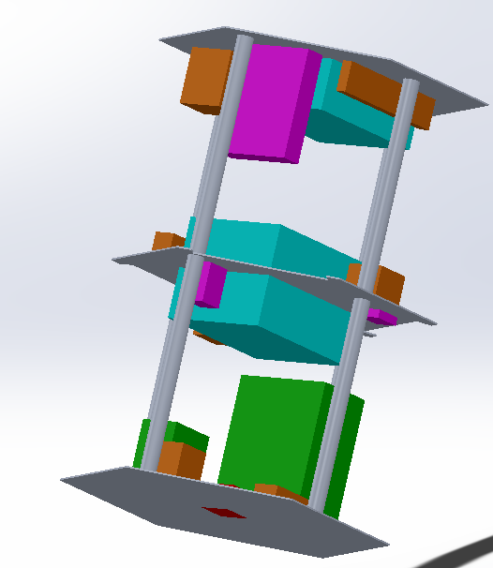
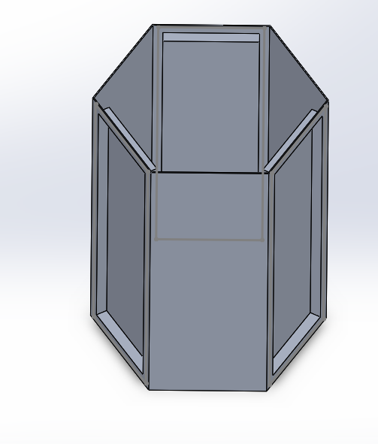
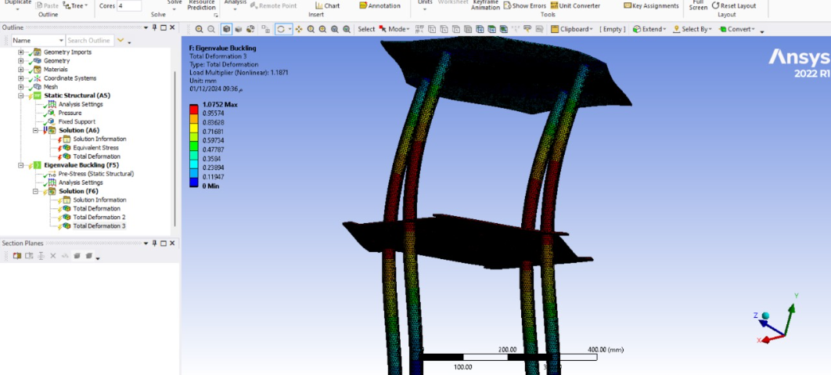
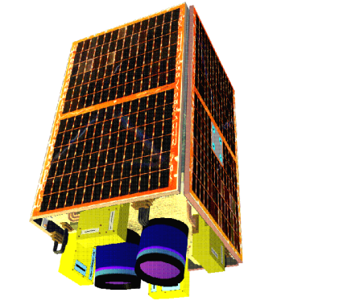

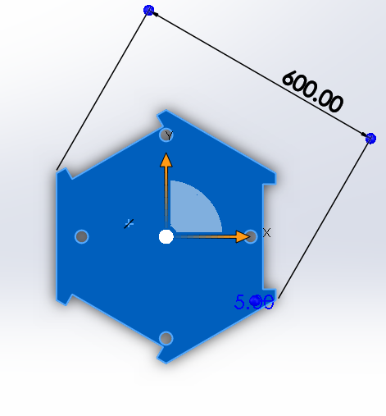
Prince Sattam bin Abdulaziz University
College of Engineering
Mechanical Engineering Department
Low Earth Orbit (LEO) Microsatellite:
Design and Development of a Microsatellite
Students: Abdulmjeed Eidan Algamdi
Supervisors: Dr. Khalid Aljohani & Dr. .Mutabe Aljaghtham .
1st Semester 1446 / 2024-2025 GP 2
microsatellite
A microsatellite, also known as a CubeSat, is a type of small satellite that has gained popularity in recent years due to its compact size, low cost, and relatively quick development time. The term "microsatellite" generally refers to satellites with a mass between 10 kilograms and 100 kilograms.
Microsatellites have democratized access to space, enabling a wide range of organizations to participate in space-based activities
.
Small spacecraft are distinguished from more conventional bigger satellites :
Figure 3: small spacecraft mass categories
1.by their reduced size
2. easier fabrication
3. cut expenses and development time, they frequently make use of commercial off-the-shelf (COTS) components and technology.
Satellite Structural Design
Design subsystems
Objectives
Figure 5:Structural Design
with skin and solar
the project aims to design microsatellites for Earth observation. It involves:
1.designing the external structure and internal components using SolidWorks.
2.optimizing the moment of inertia to achieve zero resistance and minimum weight .
3.conducting thorough design tests using ABAQUS to ensure the satellite's structural integrity and performance
The objective of a micro monitor camera for Earth observation is to capture high-resolution imagery and video of the Earth's surface
Microsatellite Constellation for Disaster Monitoring
Figure 6:center of gravity
the objective of the disaster monitoring network space segment is to establish a constellation of microsatellites with advanced imaging capabilities to monitor and assess disaster events
disaster monitoring network space segment consists of a network of 70 kg microsatellites that will be deployed in a single plane around a 772 km
Stress analysis in Ansys
Figure 7:skin
Figure 9:New Structural Design with parts
monitor micro camera.
Figure 2:
Figure1:Microsatellite Constellation for Disaster Monitoring
Figure 8:Layer middle
Result Buckling analysis in ANSYS

