Slide 1
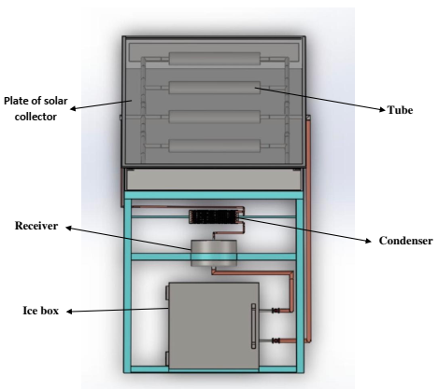
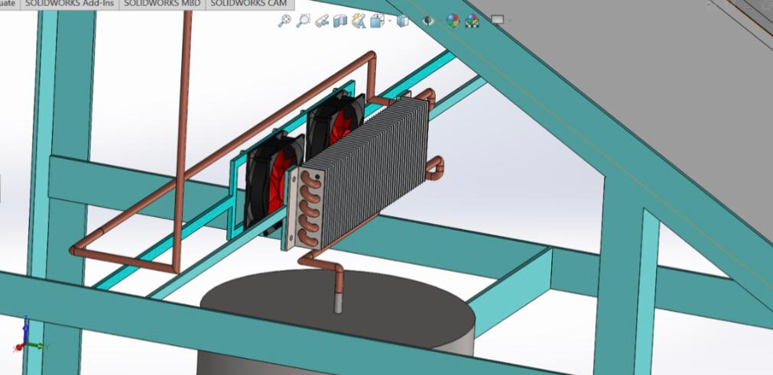
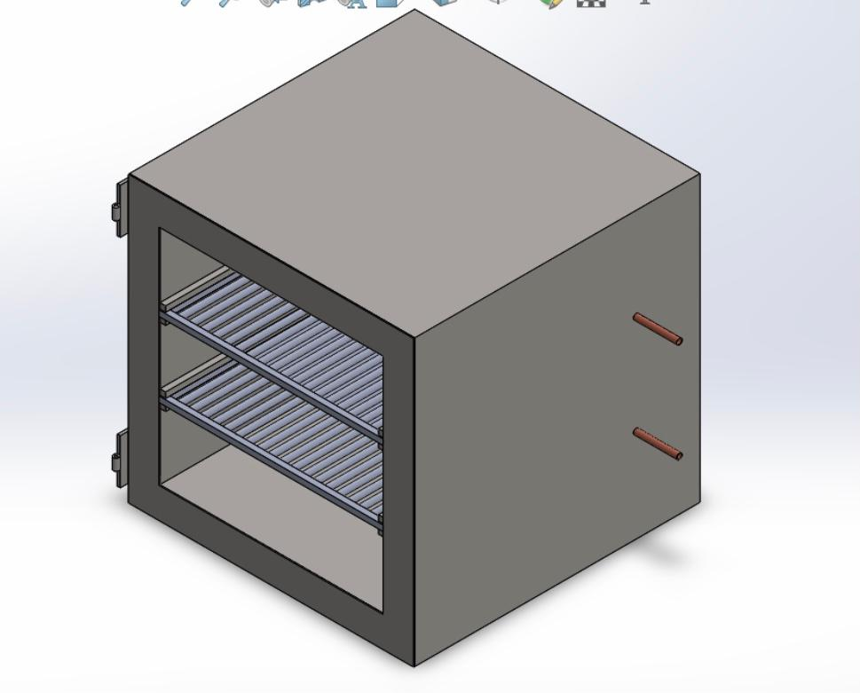
Kingdon of Saudi Arabia
Prince Sattam bin Abdulaziz University
College of Engineering
Mechanical Engineering Department
Study and Design of Solar Powered Ice
Maker
Students :
Turki Mathker Alotibi , Yazeed Ghanem ALanazi , Nawaf Mohammed Alquraini , Majed Abdulaziz Almuhaini
Supervised by :
Dr. Lamjed Hadj Taieb , Prof. Abdulkader Abdullah
2nd Semester 2021/2022
ABSTRACT
DESIGN
Modeling
First, we will make a quick review for the concept of solar energy and some techniques that are used to produce ice. Secondly, we present the adsorption technique that we have chosen to product ice. The principle of action and the properties of each component in this device are explained. After that, we develop the design and the calculation of the absorption ice maker machine that involves the important equations and we use the MATLAB program to solve these equations and perform calculations that help in designing all parts of the ice maker machine. For the design, we created the 3D drawing through SolidWorks Software and the 2D technical drawings. Finally, we talk about safety, maintenance and the cost of the ice maker machine.
The device has many advantages, including:
Very suited for developing countries.
Simplified design.
Low maintenance.
Extended life time.
Renewable energy consumption.
Don't need electricity.
The model is based on the heat balance equations of the solar collector, the combined absorption layer, the condenser and the evaporator:
The general energy balance at steady state of the evaporator is given by:
Mass of methanol:
The general energy balance at steady state of the condenser is given by:
The energy balance at steady state of the collector is given by:
$$Q=M_{ice}{∗C}_{pw}∗\left(T_{iw}−T_{w}\right)+\left[L_{ice}+C_{pice }∗\left(T_{w}−T_{ev}\right)\right]$$
$$M_{m}=\frac{Q_{ev}}{L_{m}+{Cp}_{l}\left(T_{cond}−T_{ev}\right)}$$
$$Q_{cond}=M_{m}∗\left[L_{m}+{Cp}_{l}∗{(T}_{coi}−\left(T_{cond}\right)\right]$$
OBJECTIVES
$$Q_{sol}=Q_{ads}+Q_{loss}$$
- Study and Design of Solar Powered Ice
Maker.
- Calculations and sizing the different parts of the machine.
Cost analysis.
CONSTRAINTS
Our study take in consideration the following constraints:
Safety
Environment
Economic
DESCRIPTION
Figure(1) :Components of the ice making machine
The Solar Power Adsorption Refrigeration machine consists of four main components: a solar collector, a condenser, evaporator and ice box.
The machine work in a process divided into two periods, in the morning and at night. Adsorbent is activated carbon and the adsorbed is Methanol. In the morning, when the collector is exposed to sunlight, the tubes get heated up and the activated carbon releases the methanol as a vapor inside these tubes. Then, the methanol vapor goes to the condenser, which is condensed to a liquid and stored in the receiver below the condenser as in figure (1). After condensing the methanol from vapor to liquid, the temperature is very low. During the nighttime the valves open and the liquid methanol goes from receiver to evaporator inside the ice box. In this period of the absorption process, the methanol turns to vapor by absorbing heat from the water, and the water inside the ice box cools and becomes ice. The methanol turns into vapor and goes to the adsorbent bed where the pressure and temperature are low because it does not take solar radiation in the night and is absorbed by activated carbon in the adsorbent bed.
COST ANALYSIS
Collector has the highest cost that represents 48% of the total device cost .The total cost of the device is around 4150 SAR.
Figure(2) : Fan connection with the condenser
CONCLUSION
The device is designed according to safety standards,
The device produces approximately five kilograms per day,
The adsorption systems depend strongly on the adsorption and condensation temperatures,
Activated carbon is one of the most important methods of adsorption,
The ice produced can be used for various purposes such as in hospitals or for domestic use.
Figure(3) : Ice box

