Slide 1
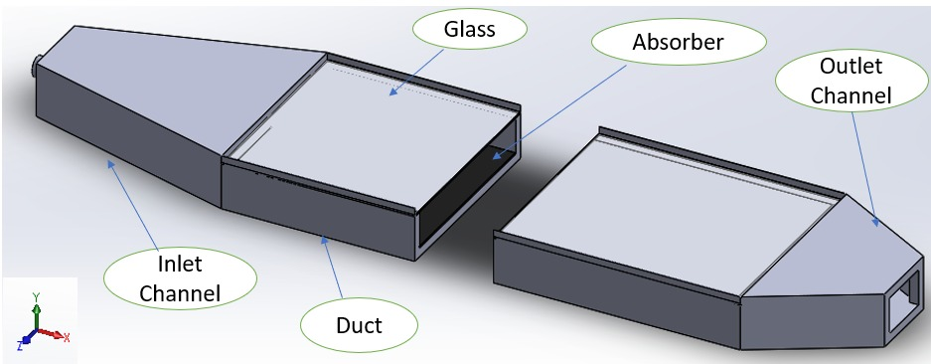
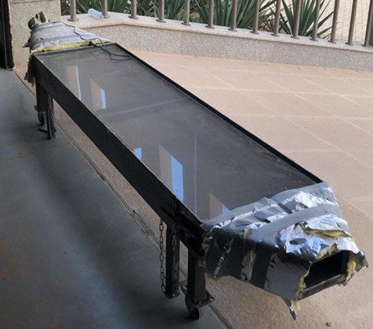
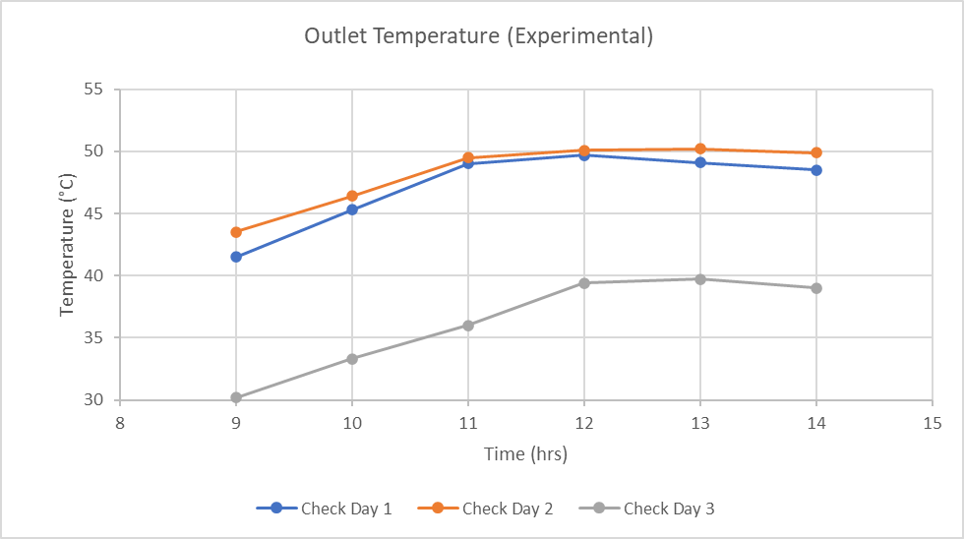
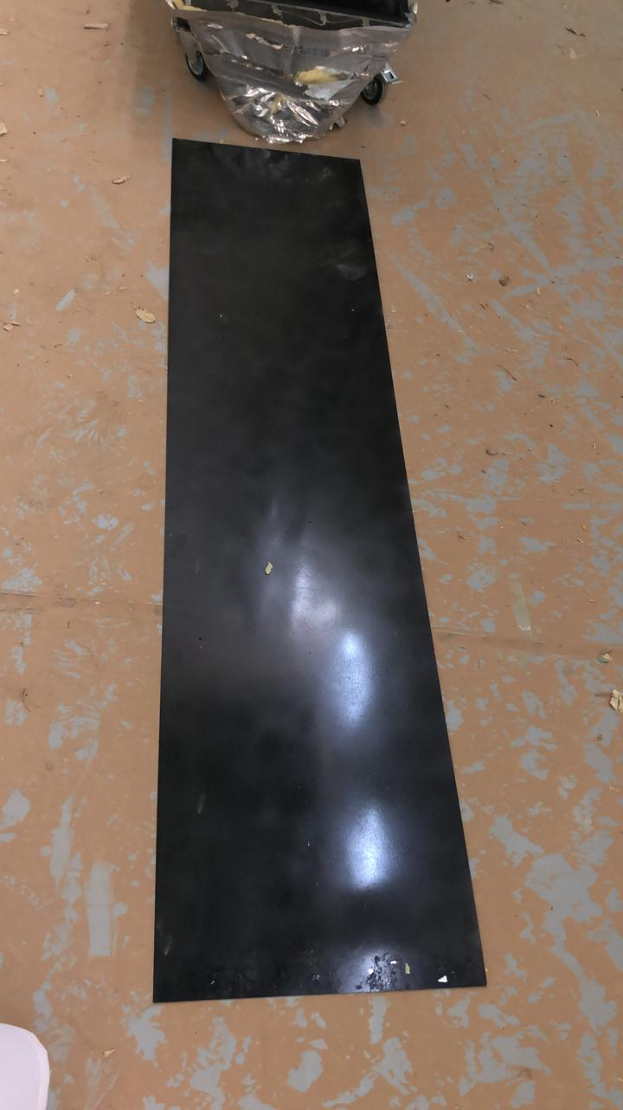
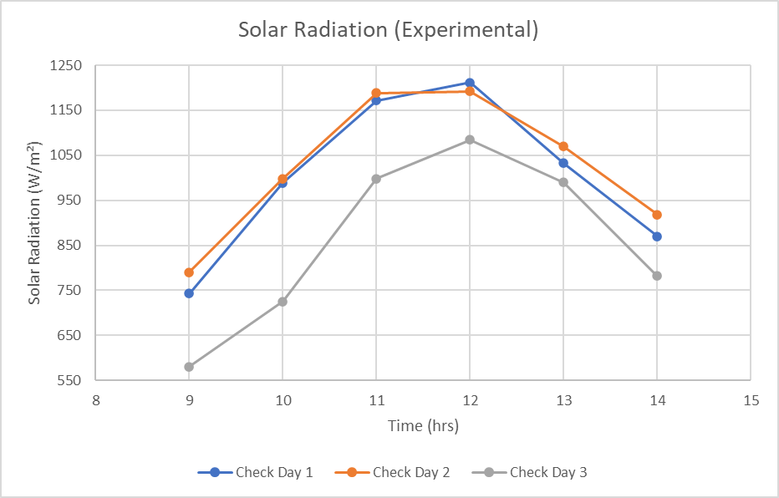
Kingdon of Saudi Arabia
Prince Sattam bin Abdulaziz University
College of Engineering
Mechanical Engineering Department
Design of Solar Air Heater
Students :
Abdullah Omar Alyemni, Abdullah Nasser Alkudair , Abdulrahman Khaled Alrumaih
Supervised by :
Dr. Umar Fahed Alqsair , Dr. Mutabe Saad Aljaghtham
2nd Semester 2020/2021
ABSTRACT
DESIGN
Modeling & Simulation
Solar air heater SAH considers a heat exchanger device which is one of the sources to absorb the heat from the sun and increases the ambient temperature by sun radiation. In this project, we performed numerical and experimental design of SAH, how and where to install it. The SAH is a renewable energy application which can be utilized to reduce the energy consumption, and the environmental pollution. We designed flat plat single pass of SAH with absorber dimensions of 2 m length, 0.5 width and 0.1 m height. The measurements of the radiation, outlet temperature, temperature of absorber and the ambient temperature are quantified for three days on the month of March 24th, 25th and 28th, 2021. The numerical results obtained by MATLAB were agreed with those experimental results which showed that the maximum outlet temperature was obtained on the day 2 (March 2021, 25th) at 1:00 PM which equals to 50.2 °C. The maximum thermal efficiency was measured in the second day at 9:00 am which equals to 58.37%.
Keywords: Solar Air Heater (SAH), Outlet Temperature, Radiation.
This kind of installation has many advantages:
Simple design.
Low cost.
Low maintenance.
Renewable energy consumption for our country.
The model describing the behavior of the SAH system is based on governing equations:
Reynolds number:
Mass flow rate :
$$ṁ=ρ×A_{cs}×V_{air}$$
The useful energy:
$$Q_{u}=ṁ×Cp×(T_{outlet}−T_{inlet})$$
Thermal efficiency :
$$η_{th}=\frac{Q_{u}}{IA}$$
$$Re=\frac{ρ×V_{air}×D_{h} }{v}$$
Figure 1. 3-dimensional view of the SAH.
OBJECTIVES
- Reviewing the literature related to the Solar Air Heater (SAH).
Design the (SAH) system.
Presentation and analysis the results.
Cost analysis.
Figure 2. The SAH system.
Figure 5. Outlet temperature result.
COST ANALYSIS
CONSTRAINTS
Duct has the highest cost that represents 42% of the total SAH system cost. The total cost of the project is 1182 SAR.
Our study take in consideration the following constraints:
Safety.
Environment.
Economic.
CONCLUSION
Experimentally, we designed SAH flat plate on horizontal surface, we measured the solar radiation and the temperatures in 24, 25 and 28 of March 2021.
The maximum solar radiation result was on March 25, 2021, at 12:00 PM and the highest value was 1192 W/m2.
For the maximum outlet temperature result was on March 25, 2021, at 1:00 PM and the highest value was 50.2 °C.
We notice that the third day was the lowest in values because of the clouds and dust.
Also, we calculated the mass flow rate equal to 0.036 kg/s which was constant in all the experimental days.
Useful energy which was at the highest value on 25 March 2021 at 12:00 PM equal to 523.87 W, the maximum thermal efficiency was on 25 March 2021 at 9:00 AM is 58.37%.
Figure 3. Absorber.
DESCRIPTION
The solar air heater system which consists of absorber, glass at the top, insulator and blower as shown in figure 1 and figure 2 . The absorber is metal plate with a black color to absorbs radiation of the sun, glass at the top to collect the greatest amount of radiation as possible, insulator to prevent the heat losses, and The blower device flow air from surrounding (ambient air) above absorber to generate hot air by conviction. Design has two channels with trapezoid shape and a guide vanes in the inlet channel to distribution of air .
Figure 4. : Solar radiation results.

