Slide 1
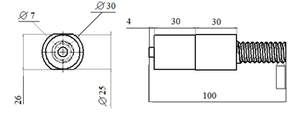
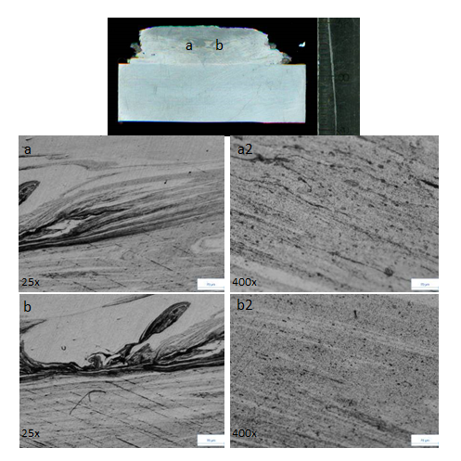
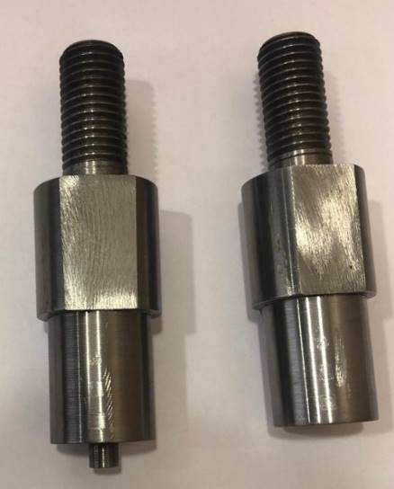
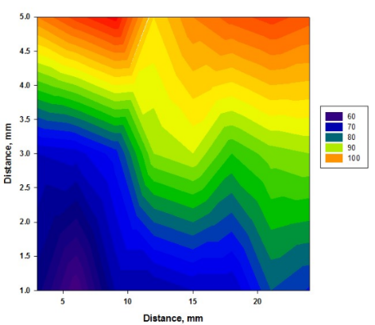
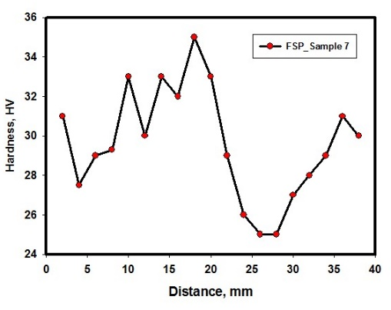
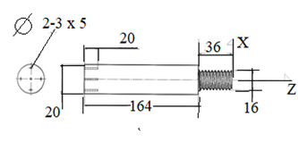
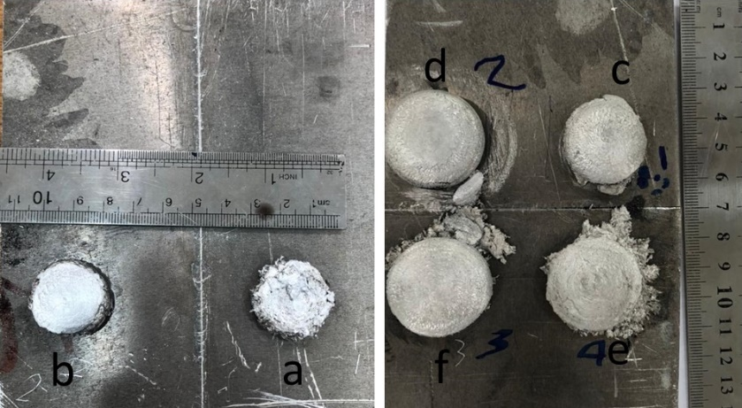
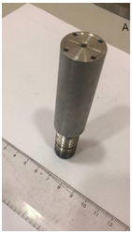
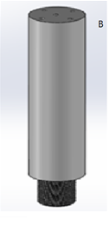
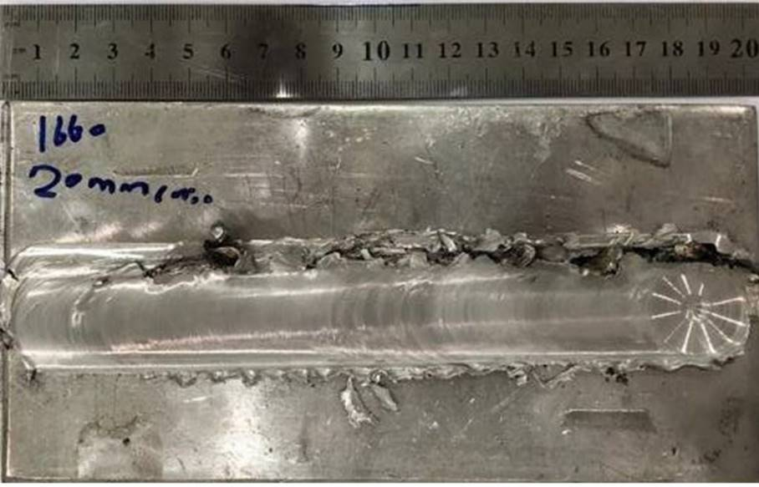
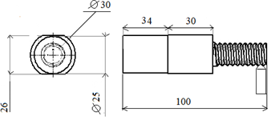
Kingdon of Saudi Arabia
Prince Sattam bin Abdulaziz University
College of Engineering
Mechanical Engineering Department
Development of metal matrix nanocomposites using friction stir deposition
Students:
Fahad Hameed Alanazi, Fahad Alqahtani and Abdulsalam Alqahtani
Supervised by:
Prof. Mohamed Zaky, Dr. Kamel Touileb , Dr. Hussein Alrobei and Eng. Abdejlil Hedhibi
Semester 2 – 2020/2021
ABSTRACT
Friction stir deposition (FSD)is one of the promising new techniques for additive manufacturing in the solid state using consumable tool Figure 1 to meet the requirements of many industries where very fine grain size, nanosized structure, increasing of mechanical properties, toughness and electrical or thermal conductivity .friction stir processing (FSP) has been developed which is an important technique for preparing surface composites using non-consumable tool Figure 2. We use FSP and FSD to produce MMNCs Figure (3,4). The aim of this study is to compare the microstructure and hardness map distribution in deposited specimen with CNT and without CTN.
Figure 5:FSD Optical microstructure ,ex2.4
Figure 6:Hardness distribution colored map
of FSD ex2.4
OBJECTIVES
To develop MMNCs using friction stir deposition as a solid state additive manufacturing technique
To develop MMNCs using friction stir processing as a solid state technique
To study the effect of CNT particles on the mechanical properties of aluminum
Table1:FSD parameters used in this work
Experiment | Diameter of holes (mm) | Spindle speed (rpm) | With CNT
1.1 | 2 | 850 | With CNT
1.2 | 2 | 850 | With CNT
2.1 | 3 | 850 | With CNT
2.2 | 3 | 850 | Without
2.3 | 3 | 850 | With CNT
2.4 | 2 | 495 | With CNT
Figure 7:Hardness curves of FSP
Experimental work
Experimental work
H13 steel
Characterization
Optical macrograph (scanner)
Raw materials
CNT
FSP
FSD
AA6061
AA5083
AA1050
Rotational speed (495-850) rpm
2 grooves of (2,5)mm wid & dep
Rotational speed (1660)rpm
AA5083& AL6061rod
Plates of (6x100x200)mm
Plate of (200x100) mm
Tilt angle 3ͦ
Consumable tool
Non-consumable tool
AA1050& H13 steel
Traversing speed
(20-45) mm/min
Holes diameter (2,3)mm
Hardness test
Impact test
Optical microstructure (OM)
Metallography
Grinding
Polishing
Etching
Table2:Results
Experiment | Spindle speed (rpm) | Pinless Feed (mm/min) | Pin Feed (mm/min) | Tilt angle
1 | 1660 | 108 | 45 | 3
2 | 1660 | 108 | 45 | 3
3 | 1660 | - | 45 | 3
4 | 1660 | 108 | 20 | 3
Table 3: Impact test results of FSP
Sample | E_{A}
Base material | 38.8 J
45 mm/min (without nano) | 31 J
45 mm/min (with nano) | 13.49 J
20 mm/min (with nano) | 21 J
Figure 1:FSD TOOL
Figure 3 :Results of FSD
Conclusions
FSD is promising technology for the development of MMNCs and ultra-fine grain structured materials.
Number of MMNC samples are successfully produced using FSD with diameter ranging from 20 to 25 mm and height ranging from 25 to 40 mm.
The macro investigations showed no defects in the samples and initial micro investigations showed that CNT powder is very well distributed in the aluminum matrix and enhance the properties Figure 5.
Hardness distribution maps Figure 6 are constructed and showed that the hardness of FSAMed samples is significantly improved by reducing the tool rotation rate due to the reduction in the heat and temperature and by increasing the hole's diameter as this increases the CNT volume fraction.
Number of samples of MMNC are developed using FSP and macro investigations showed that FSP also results in defect free MMNCs with enhanced hardness Figure 7 with reduction in impact toughness which indicates tendency to brittleness of the material.
Further investigations are required to examine the tensile properties and the distribution of the CNTs and their effects on thermal and electrical properties.
Figure 4 :Results of FSP
Figure 2:FSP PINLESS AND PIN TOOL

