Slide 1


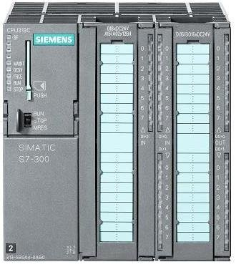
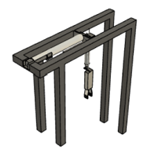
Kingdon of Saudi Arabia
Prince Sattam bin Abdulaziz University
College of Engineering
Mechanical Engineering Department
Design and Implementation of a small scale of automated conveyor system
Students :
Abdullah Maziad Alotaibi , Majed Abdullah Algarni, Mohammed Awad Alqahtani
Supervised by :
Dr.RachidDjoudjou, Dr. Tlili Messai
2st Semester 2020/2021
ABSTRACT
In the process or manufacturing industry, raw materials and products need to be transported from one manufacturing stage to another. Material handling equipment are designed such that they facilitate easy, cheap, fast and safe loading and unloading with least human interference. All hardwiring on machines has been now reduced due to PLC programmable logic controller. Biggest advantage is that logic of the machine can be changed without much alteration on the electrical side. The idea is to have sensors to sense objects and indicate to PLC. Program in PLC will move the object to location, pick the object and bring it to predefined location using the handling unit.
Keywords: Belt Conveyor system, Material handling equipment, Programmable Logic Control.
two 5/2 double solenoid directional control valve, one 3/2 single solenoid directional control valve two Double Acting Cylinder and one Gripper.
PLC (Programmable Logic Control)
A central control system from which one can control and program functions of several independent or dependent systems. The PLC consists of a user interface, central processor, links
to subsidiary system controls, and an electrical control interface. The PLC-type that had used is DELTA-DVP16ES2 that has 16 inputs and 16 outputs. We chose Delta PLC because of its good quality, it is easy to be programmed, has accepted the price and meet the required purpose.
RESULTS
Figure 1. Small scale of automated conveyer system
1. BELT CONVEYOR
OBJECTIVES
Table 1: PVC rubber transporting conveyer parameters
PARAMETER | VALUE
Belt Speed (v) | 1 [m/s]
Length of Conveyor (L) | 1.2 [m]
Height of Conveyor (H) | 0.2 [m]
Inclination Angle | 0°
Belt Type | 2.5 [kg/m²]
AC Motor Power | 464 [W]
Shaft Diameter | 20 [mm]
-To design and implement conveyor system that is controlled by plc which will be used in the mechatronic lab for the undergraduate students.
Figure 3. Programmable Logic Control
CONSTRAINTS
2. HANDLING MECHANISM
Explanation of the operation sequence
Our study take in consideration the following constraints:
Safety
Environment
Economic
The pieces are entered by hand in the conveyor.
Press the start pushbutton of the conveyor system, the PLC will order the drives of the conveyor to be on, then the conveyor will move until the sensor1 "photocell", detects the product.
The vertical pneumatic cylinder, move down.
When it is fully extended, the gripper catches the product.
Then it will move upward
When it is fully retracted, the horizontal pneumatic cylinder will extend
When it is fully extended, the vertical cylinder will extend
When it is fully extended, the gripper will open and the product is released.
Then it will retract
And the horizontal pneumatic cylinder will retract
A new cycle can start again
Experimental work
We have separated the project into three parts, conveyor design, pneumatic study, and finally the programming of the prototype. The first one consisted of design of the conveyor with all the necessary calculation and the conveyor can hold 15 work pieces (the maximum allowed on the conveyor at once) then the total load would be 7.5 [kg] . The second one consists of design the pneumatic mechanism to pick and place products from the conveyor. The third part contains the programming of the entire system using a Simatic step 7 software from Siemens. The hardware design consists of conveyor and the pneumatic operation. The major components of the design consist of Conveyor belt, AC motor, five Proximity Sensors, PLC (Semantic),
Figure 2. Handling mechanism
a. Selection of the two double acting cylinders
According to our calculation we have chosen a standard diameter of 20mm for the vertical cylinder and a standard diameter of 25 mm for the horizontal cylinder. Regarding the stroke length has been selected to be 100mm for the vertical cylinder and the stroke length of the horizontal cylinder has been selected to be 200 mm.
b. Pneumatic gripper
A pick-and-place device that uses compressed air to operate gripper jaws. Help in grasping, holding and releasing the work pieces.
At P = 6 bar, the clamping force is 68 N (gripping force is proportional to input pressure) so a size 1 of the gripper what we select.
CONCLUSION
We have designed the conveyor system by selecting the appropriate components dimensions.
We have designed pneumatic handling system by selecting the appropriate elements.
We have programmed PLC which control the conveyor system and the handling system.
The conveyor system is successfully designed and tested.
c. Selection of directional control valve
We select two double solenoid 5/2 DCV for the two double acting cylinder and a single solenoid 3/2 DCV 3/2 for the gripper.

