Slide 1


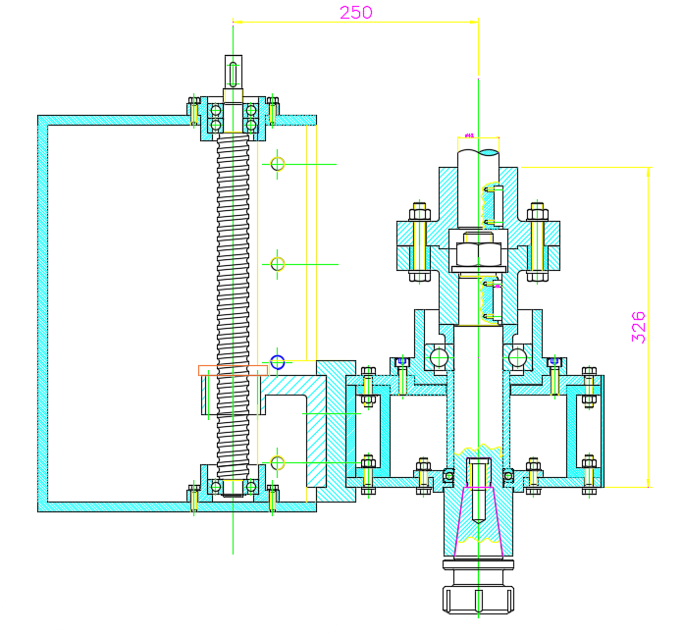
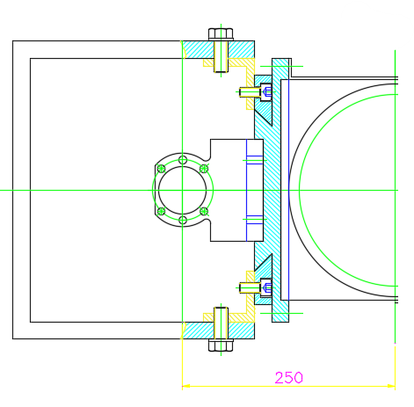
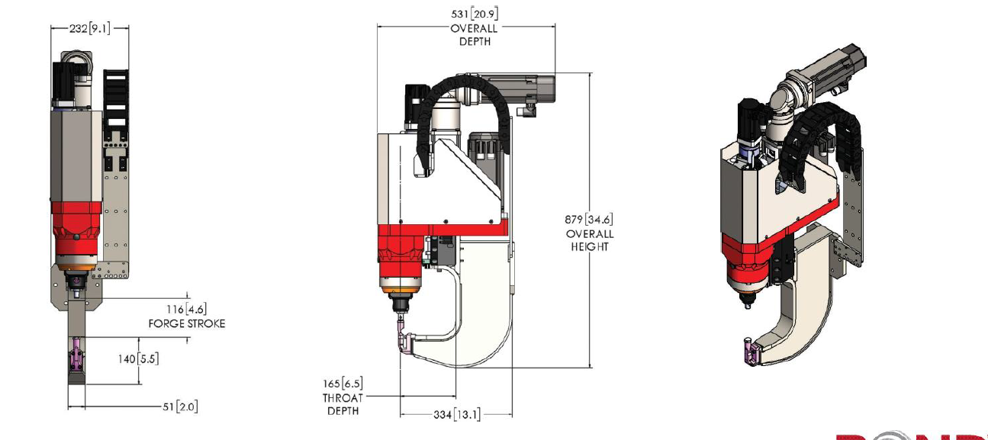
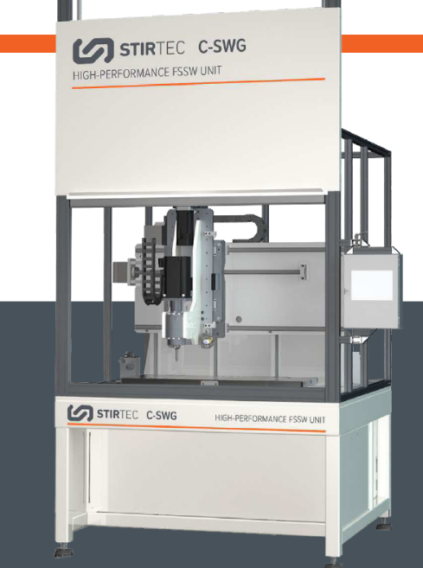
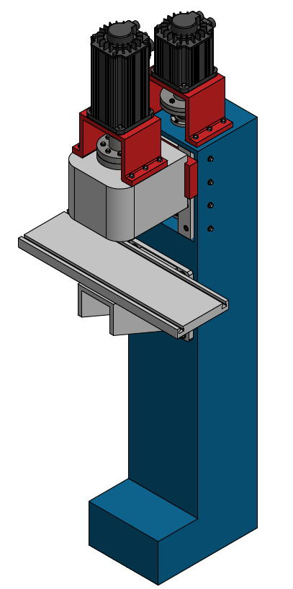
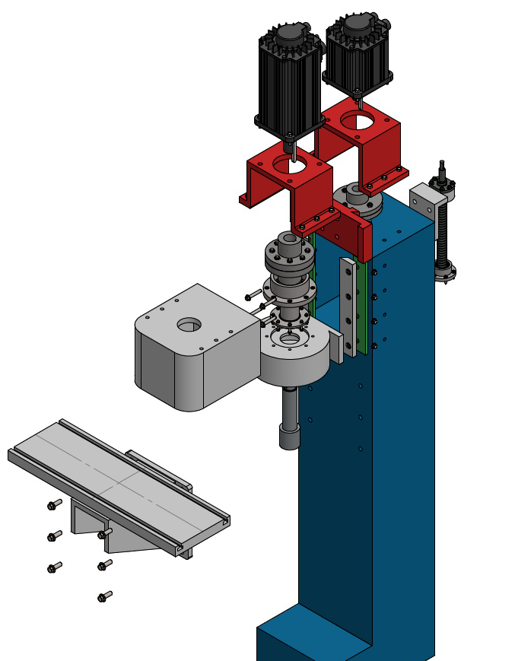
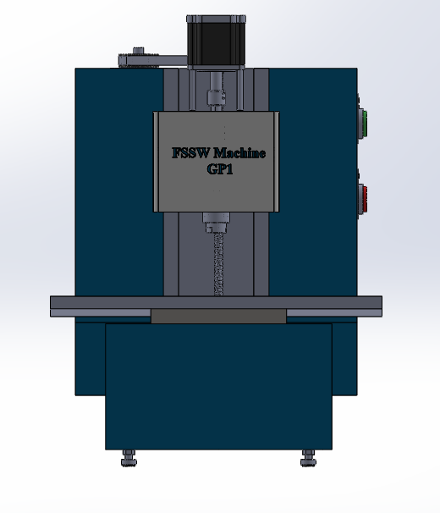
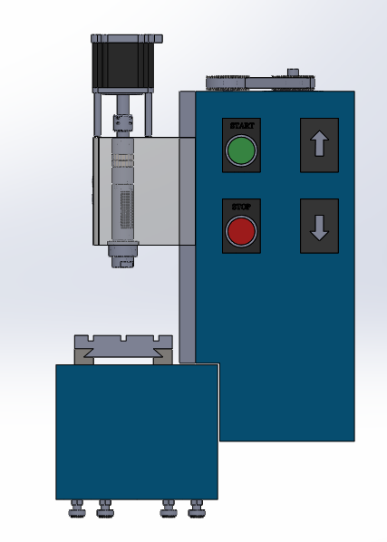
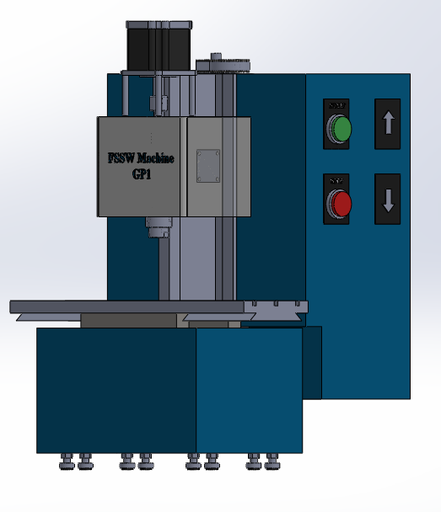
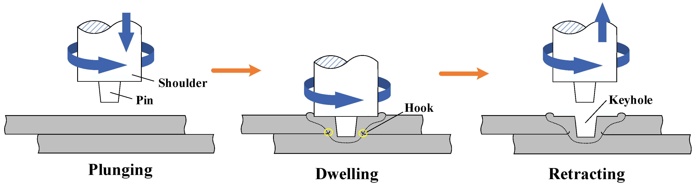
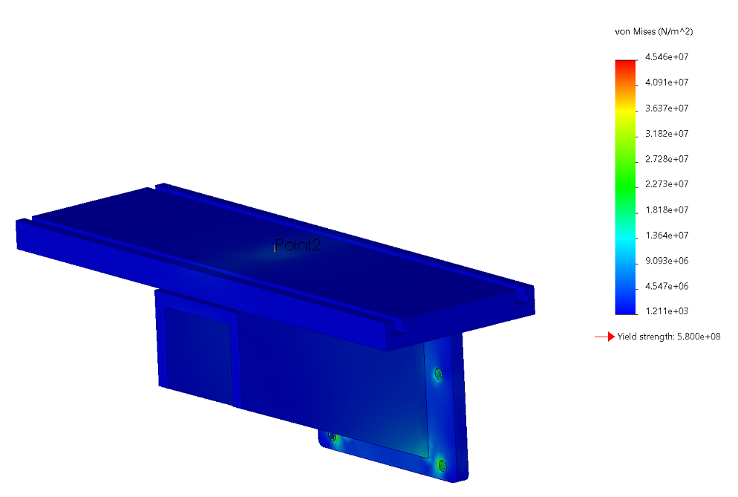
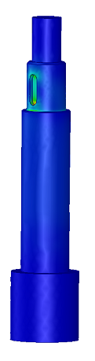
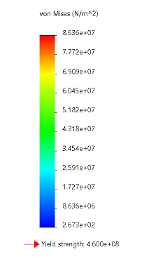
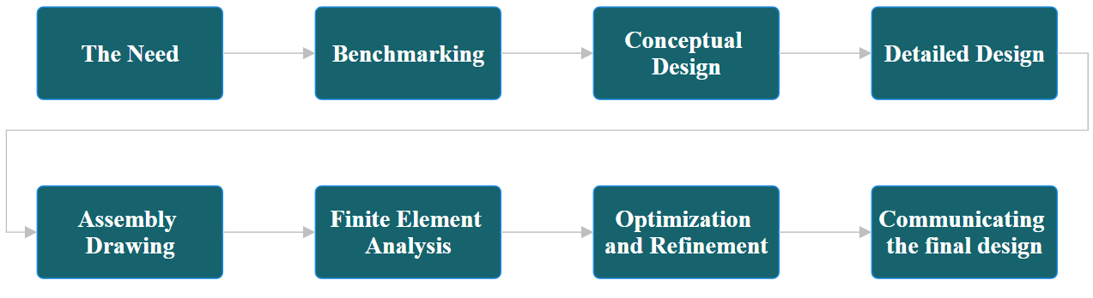
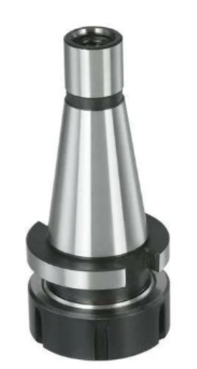
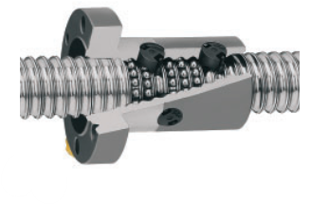
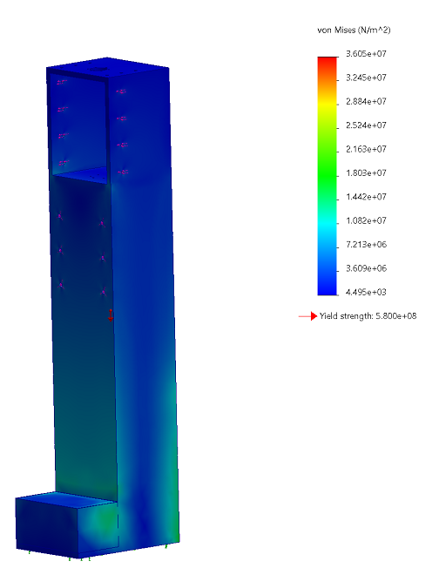
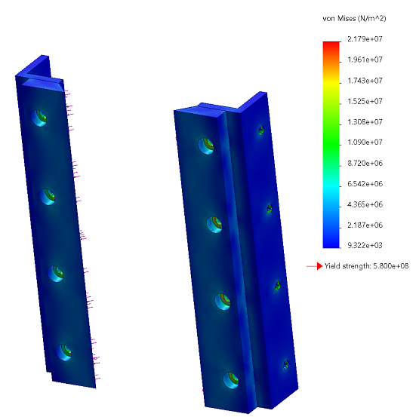
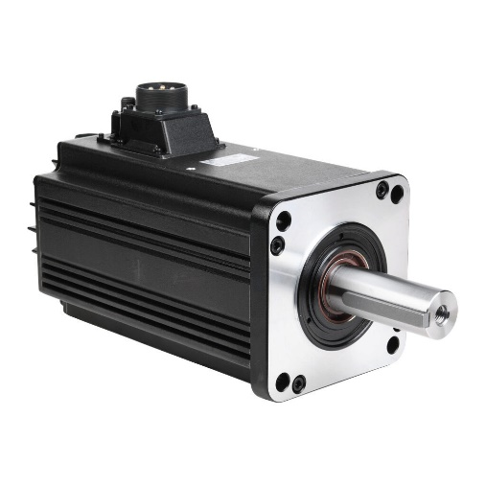
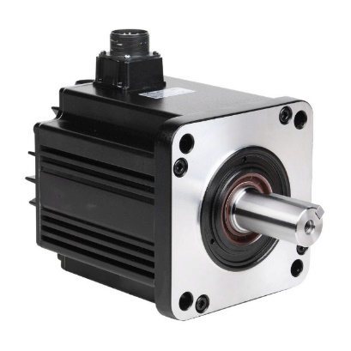
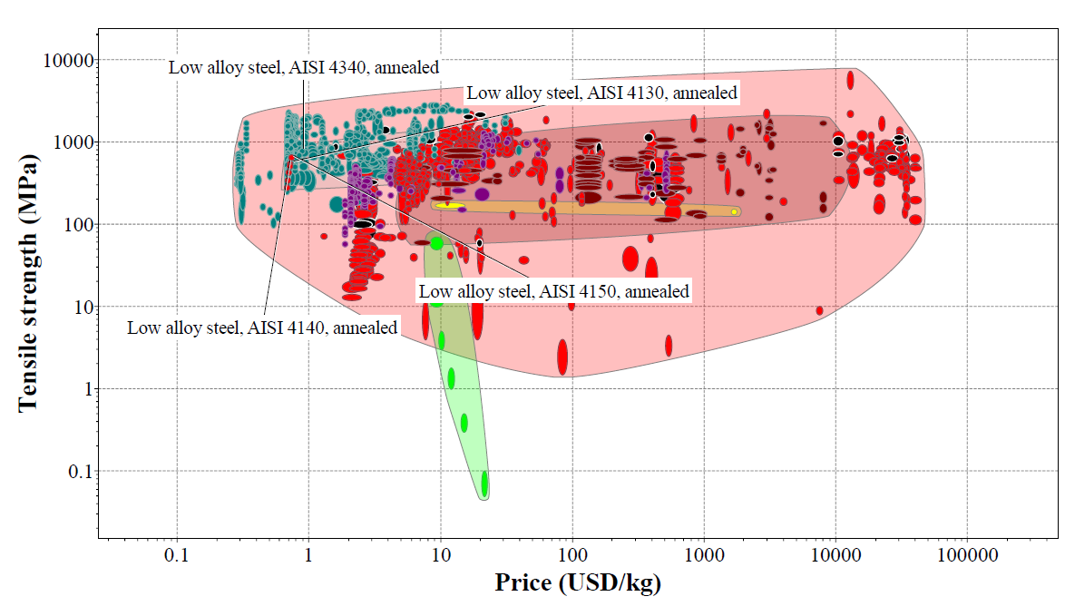
Prince Sattam bin Abdulaziz University
College of Engineering
Mechanical Engineering Department
Design and Simulation of a Friction Stir Spot Welding Machine
Students: Sohib Zaki and Abdulmajed Al-Harbi
Supervisors: Prof. Mohamed Zaky, Dr. Kamel Touileb, Dr. Bandar Al-Zahrani, Dr. Ali Abd El-Aty
2nd Semester 1445 / 2023-2024 GP 2
Abstract
Design Procedure
Final Design and Simulation
This project aims to design a Friction Stir Spot Welding (FSSW) machine tailored for welding lightweight metals. Inspired by existing machines, our design prioritizes cost efficiency while maintaining functionality. Initial specifications account for material compatibility and operational needs. The final machine achieves improved weld consistency, throughput, and versatility without excessive cost.
Through a comprehensive benchmarking stage, we initiated the design process by crafting a conceptual design for the FSSW machine, iteratively refining and modifying it multiple times to ultimately arrive at the final design.
Figure 5, 1st Stage Creating a 2D Sketch.
Friction Stir Spot Welding
Figure 3, Different FSSW exciting machine.
Friction Stir Spot Welding (FSSW) was invented by Mazda Cooperation in Japan, in 1993. The purpose of FSSW was to address and overcome the challenges typically associated with conventional-spot welding methods. Stages of FSSW can be seen in Figure 1.
Figure 4, Initial Assembly drawing of the FSSW machine.
Table 1, FSSW machine specifications for initial design.
Figure 6, 2nd Stage Generating 3D Model.
Figure 1, FSSW Process.
20 | Downward Force [kN]
20-40 | Torque [Nm]
3000-6000 | Rotational Rate [RPM]
Workbench
Spindle Shaft
Design Methodology
Standard Parts
 | ISO 40 Tool Holder
 | Ball Screw- SKF
 | Spindle Servo Motor 7.5 kW
 | Ball Screw Servo Motor 4.5 kW
Machine Body
Slider Mechanism
Material Selection
Function | Designing of Spindle Shaft
Constraints | High strength. Good machinability Low notch sensitivity factor. Good heat treatment properties. High wear resistant properties.
Objective | Minimize the Cost
Machine Specifications
Figure 7, 3rd Stage Applying Finite Element Modelling for nonstandard parts.
Table 2, FSSW machine specifications for final design.
Conclusion
10 | Downward Force [kN]
47.74 | Torque [Nm]
1500-3000 | Rotational Rate [RPM]
200 | Stroke (mm)
800×260 | Worktable (mm)
Due to their unique properties, lightweight metals pose challenges for conventional welding techniques. This project aims to address these challenges by developing a Friction Stir Spot Welding (FSSW) machine. We have completed the design of the machine and outlined its functionality.
Figure 2, Ashby Plot: Tensile Strength vs. Cost.

