Slide 1

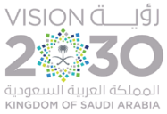
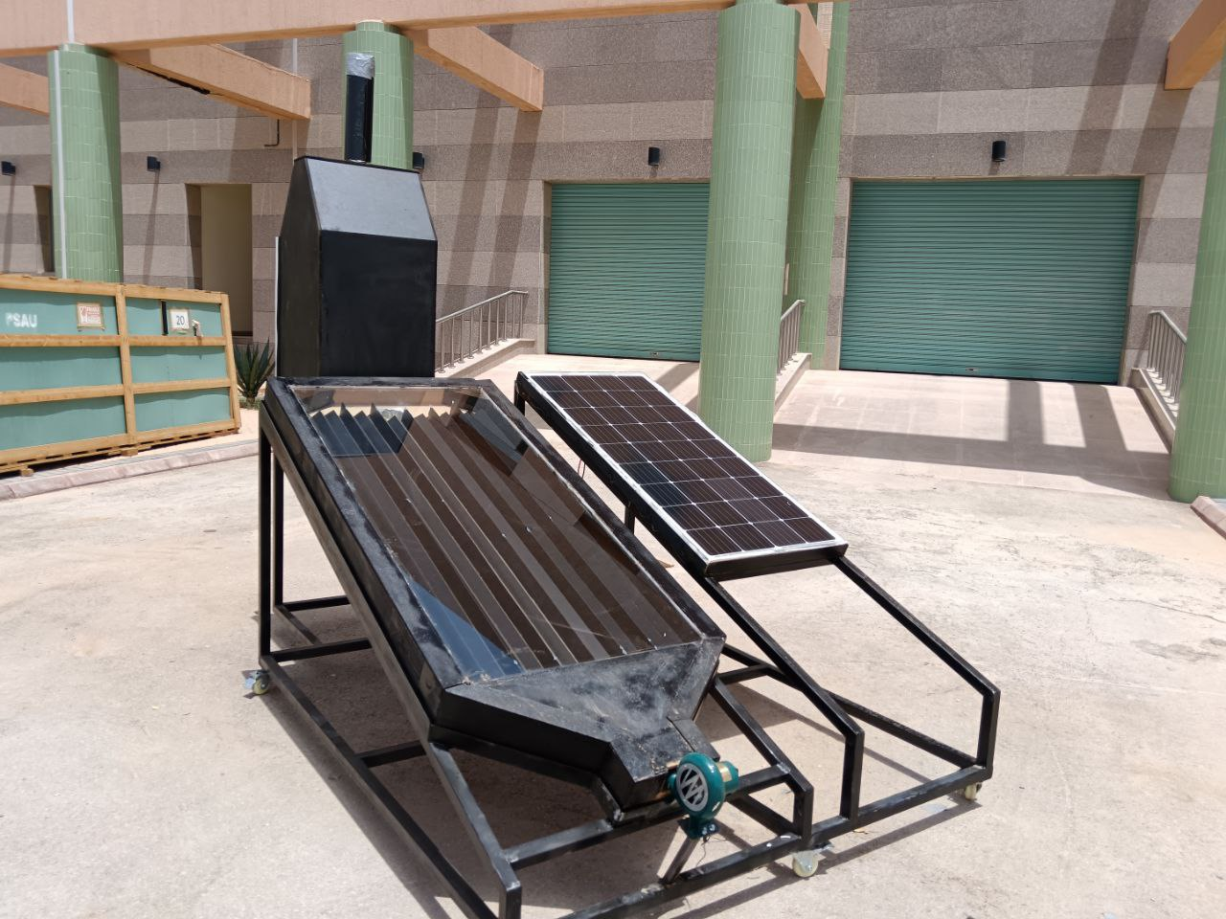
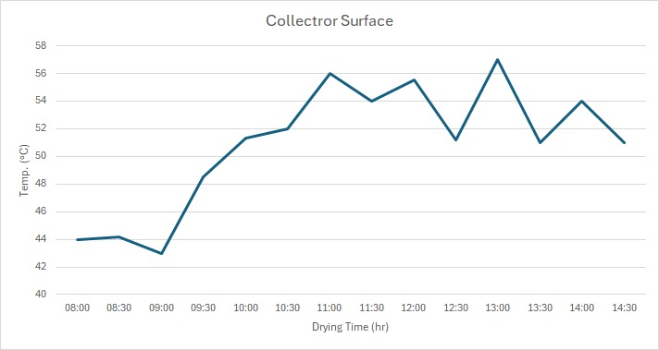
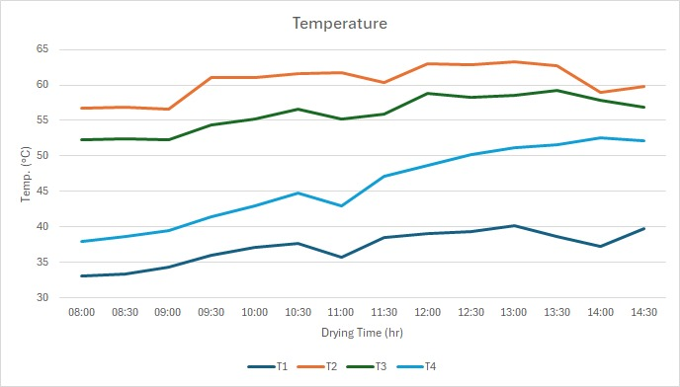
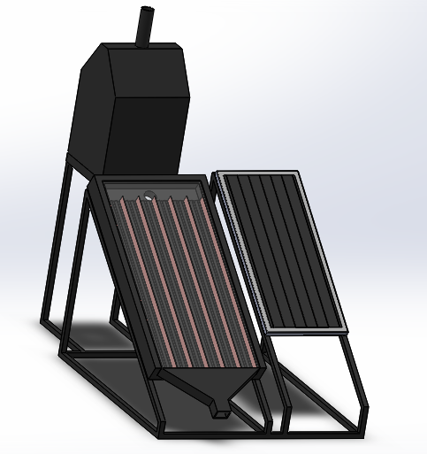
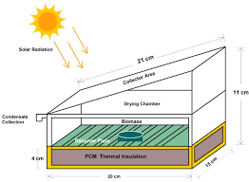
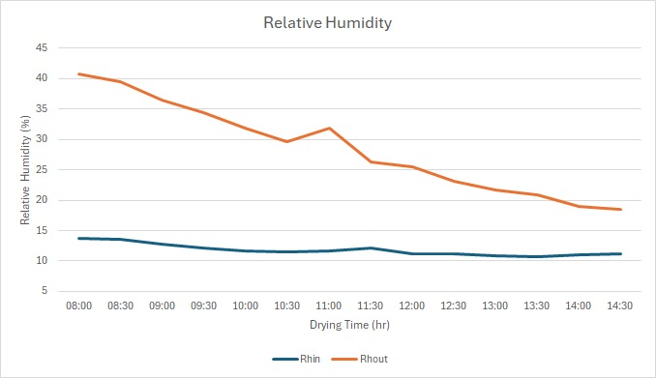
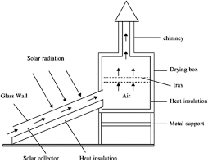
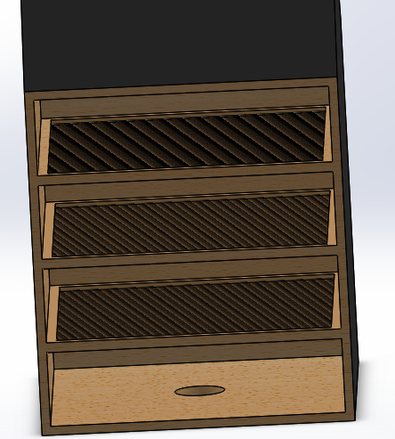
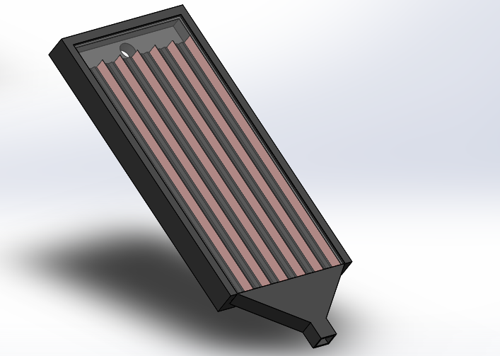
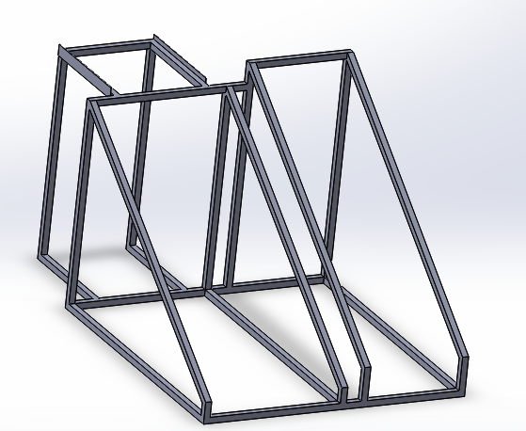
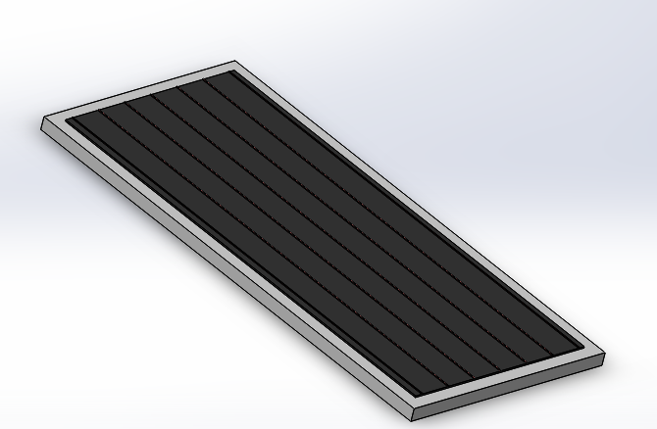
Prince Sattam bin Abdulaziz University
College of Engineering
Mechanical Engineering Department
Design, Modelling and Manufacturing of a Solar Dryer Prototype
Students: Fahad Mohsen Bin Lebdah & Abdulaziz Saleh Al-Maymouny
Supervisors: Dr. Lamjad Hadj Taieb & Dr. Habib Ben Bacha
2nd Semester 1445 / 2024 GP 2
Background of study
System design
Manufacturing process
Solar energy is one of the most important energies at this time, as it is renewable and alternative energy. Due to its diversity of uses, it can be used in several fields, such as energy production, water heating, and operating street lamps. In this project, we will use solar energy in the field of drying food crops. This is called a solar dryer
In the design process, firstly we choose tomato to be the product that we want to dry with a capacity of 3kg and initial moisture that varies from 96% to 94% and dry it between 12% - 8%.
Drying Chamber
PV Panel
NO. | Parameter | Value
Mass | Mp | 3 kg
Removed Moisture | Mw | 2.79 Kg of water
Dried Mass | Md | 0.205 kg
Heat Required | Qt | 2540.1 kJ/kg
Collector Area | Ac | 1.592 m^2
Mass Flow Rate | m_dot | 0.06 kg/s
Volume Flow Rate | V_dot | 0.072 m^3/s
Volume | V | 2540.1 kg^3
Height | H | 0.66m
Height (Chimney) | hc | 0.44
Rack Area | Arac | 0.3 m^2
Drying Time | td | 8-20 hrs
Collector
Support
Objectives
Fan
Literary review on solar dryers
Select the appropriate solar dryer.
Designing of selected solar dryer
Drawing
Manufacturing a prototype
Results
.
Important of solar dryer
Energy Efficiency
Cost Savings
Preservation of Nutritional Value
Extended Shelf Life
Reduction in Post-Harvest Losses
Increased Food Security
Type of solar dryer
Open sun dryer
Indirect solar dryer: Active flow & Passive flow
direct solar dryers: Active flow & Passive flow
Mixed mode solar dryer: Active flow & Passive flow
SOLIDWORKS drawing
Conclusion
Our solution is the Indirect Solar Dryer which has the safety for the crops from infestation and the cost effectiveness from the Mixed-Mode Solar dryer.
This project shows that when utilizing solar energy, and using the right systems, the life of agricultural products can be extended, whether by prevention of molding or by protecting the products from insects.

