Slide 1


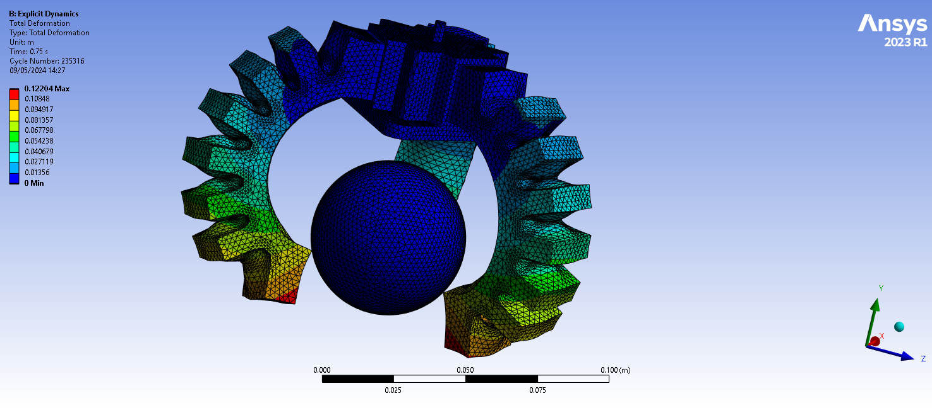
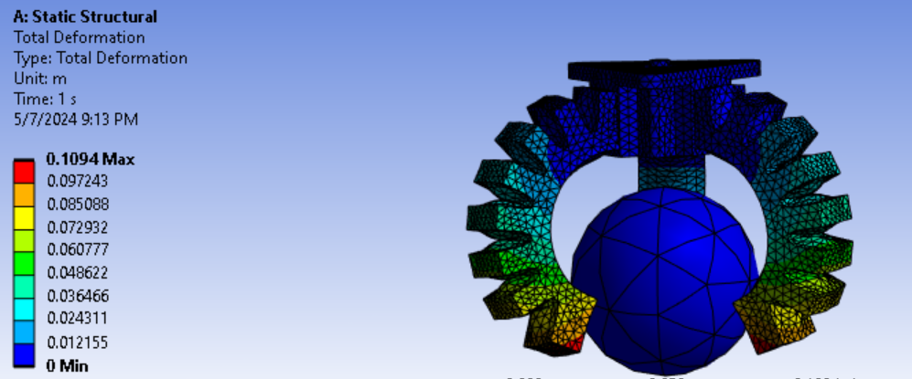
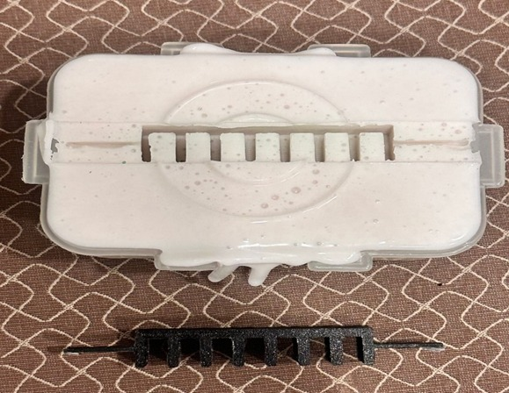
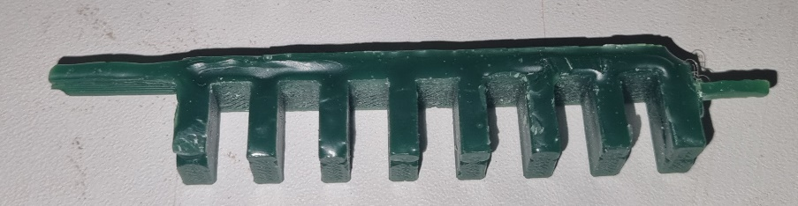
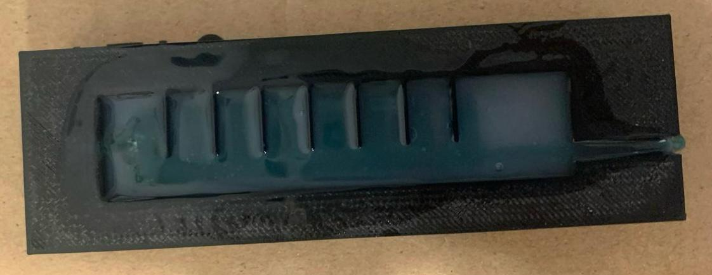
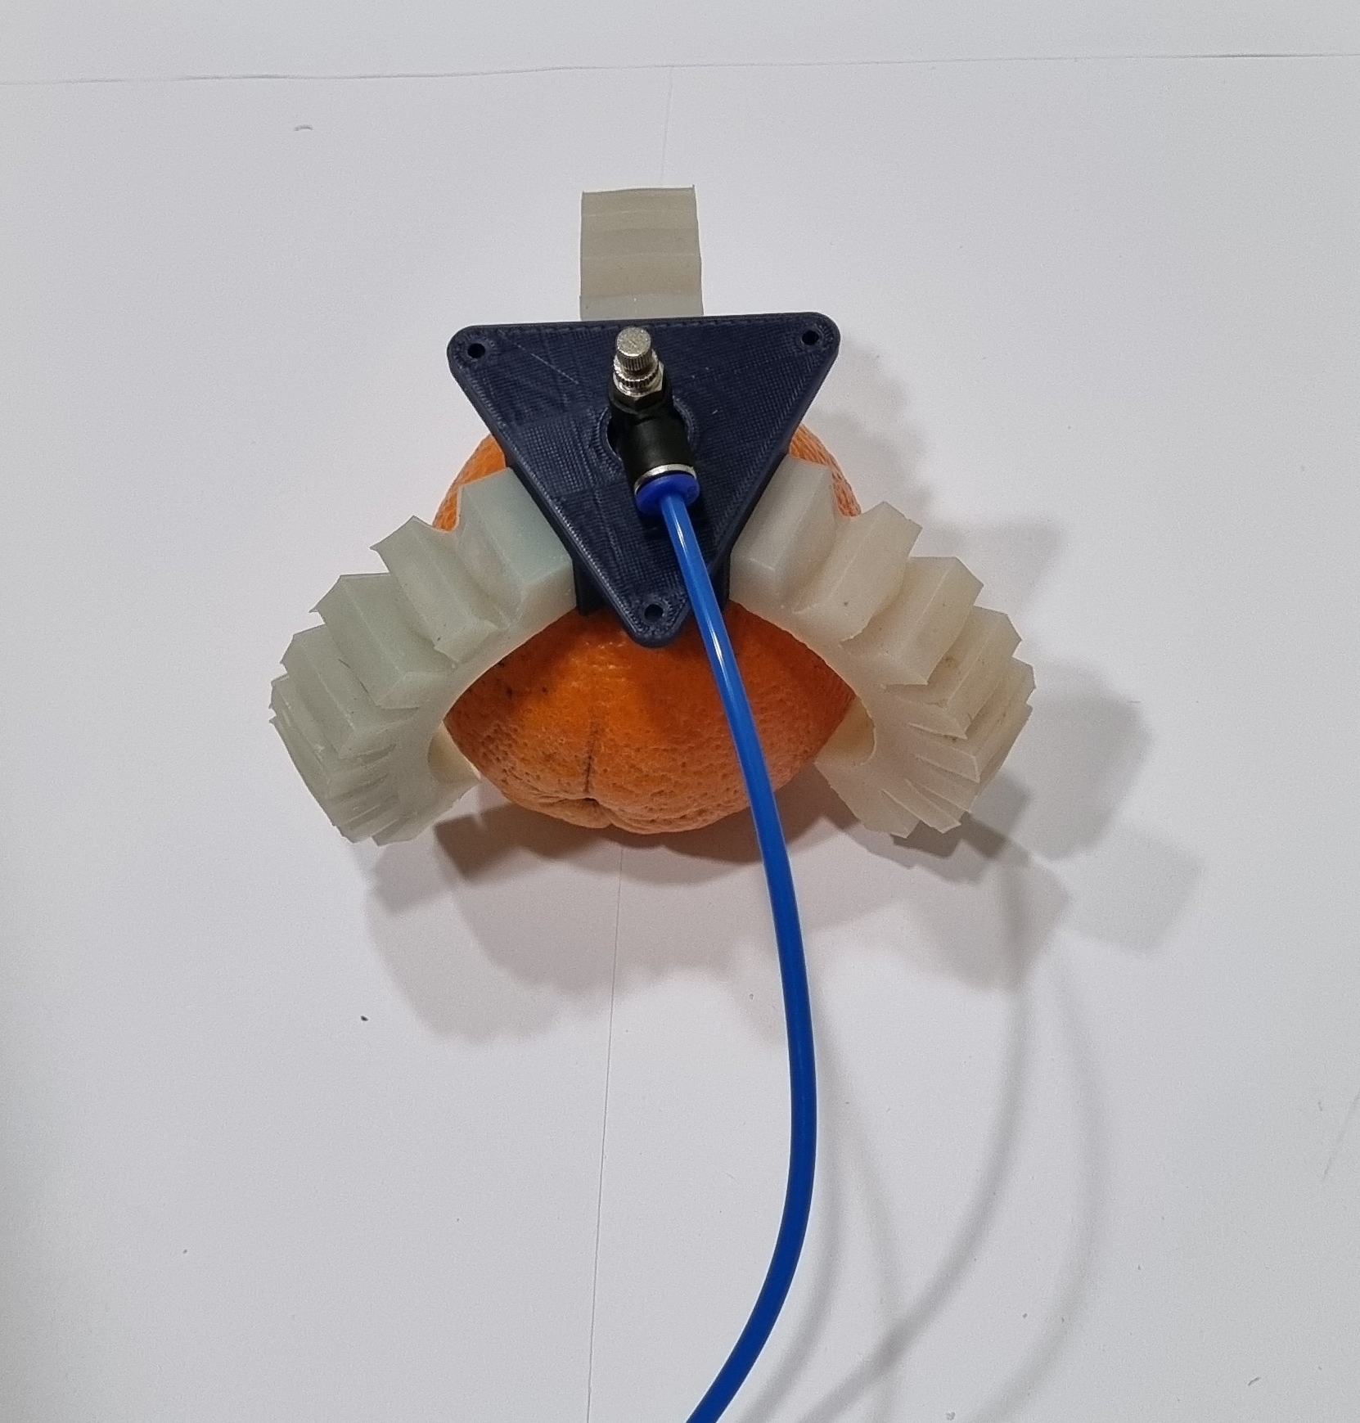
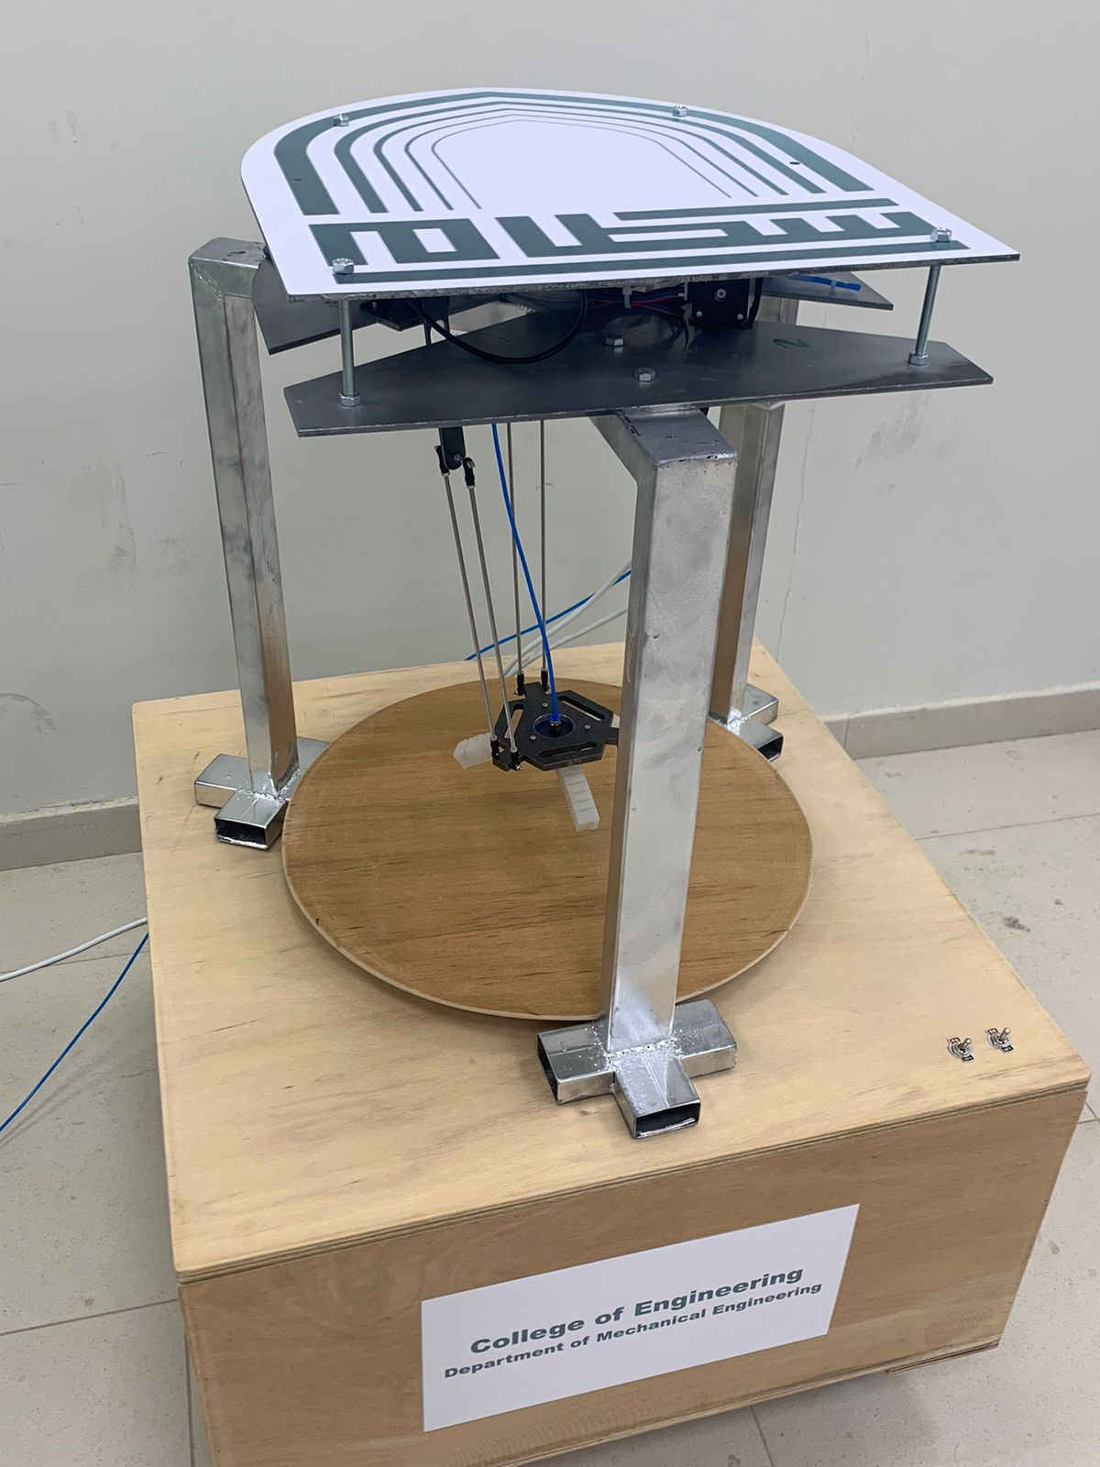
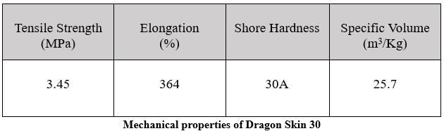
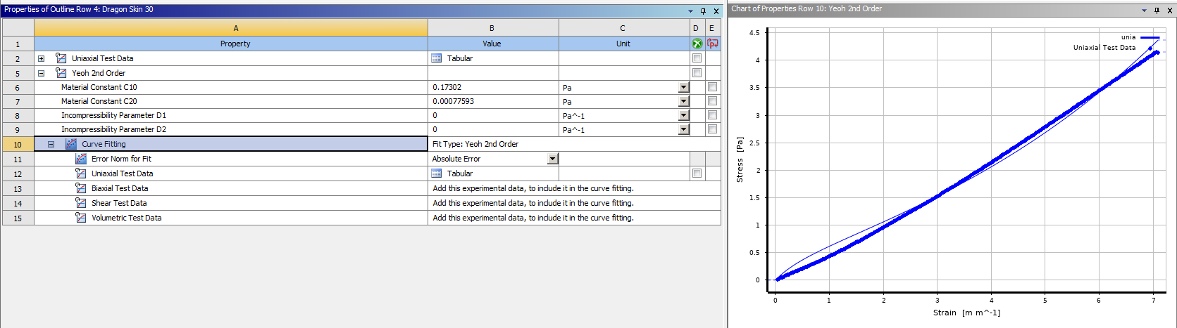
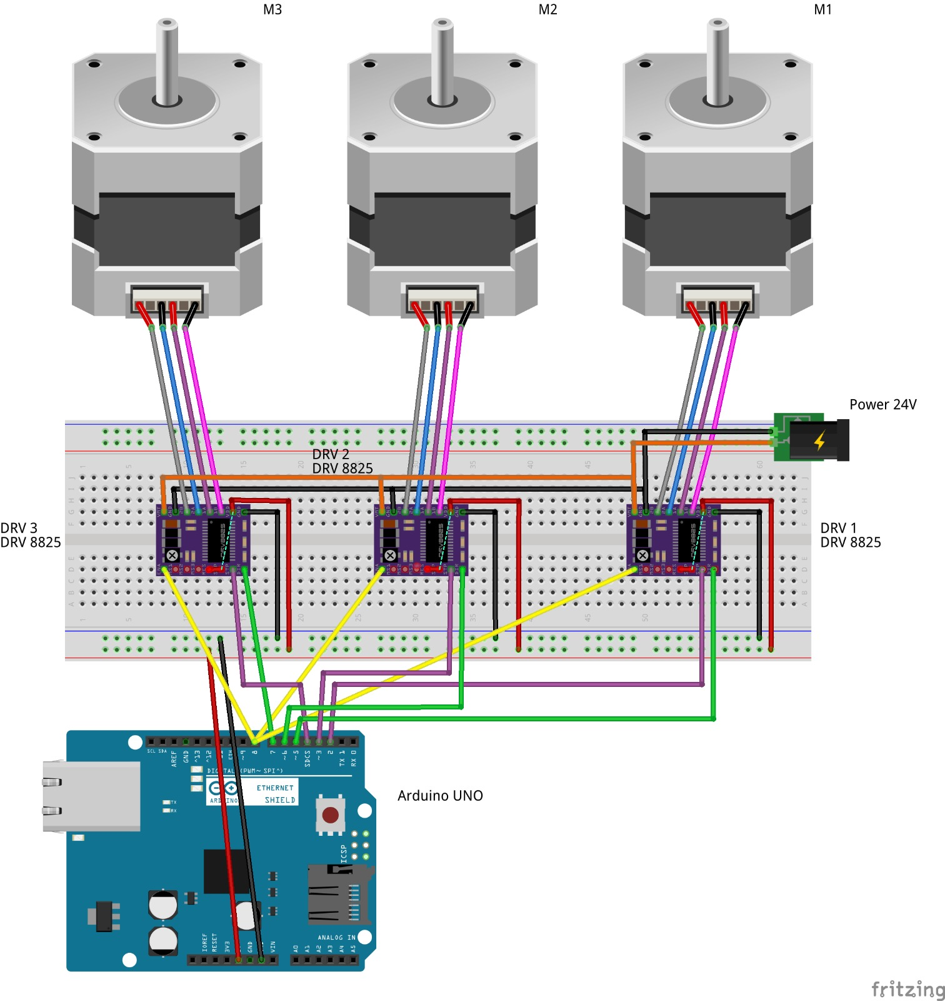
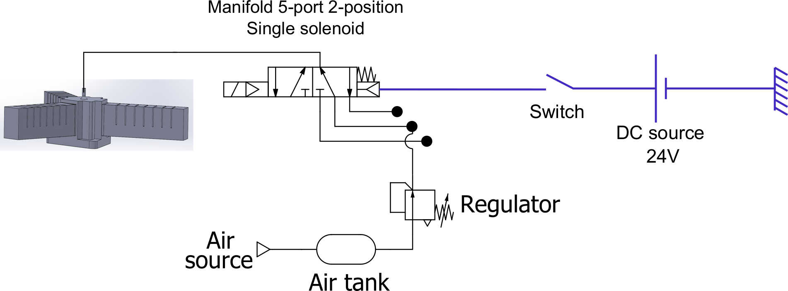
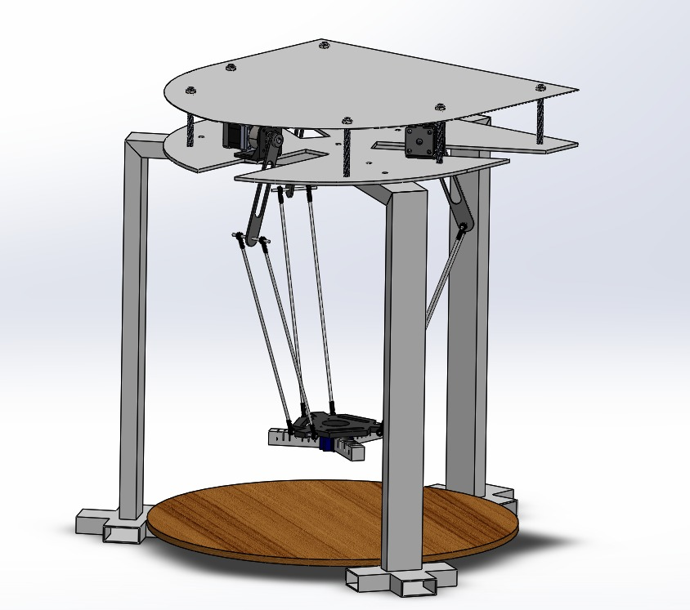
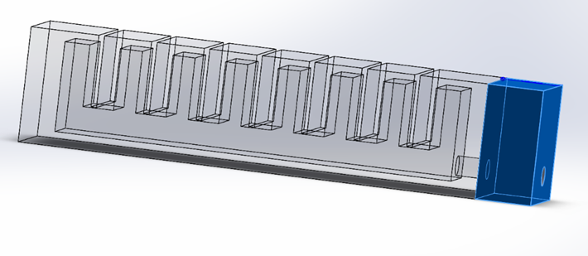
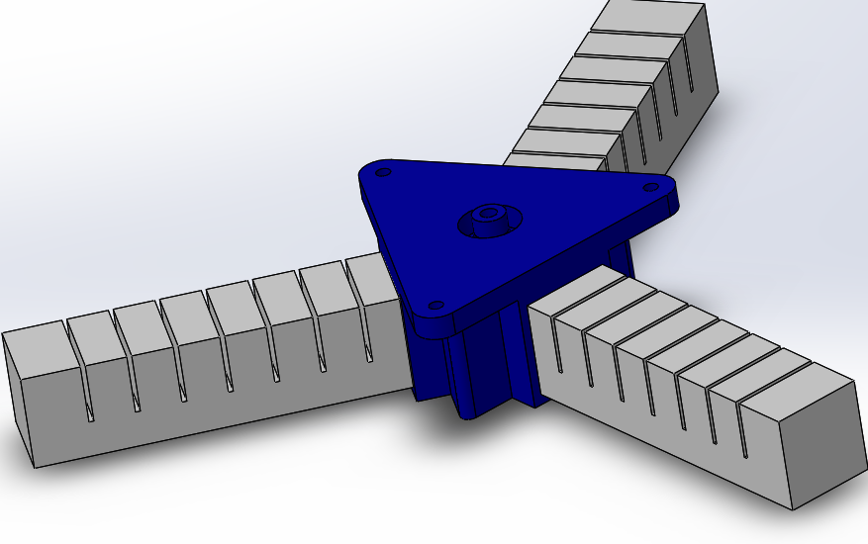
Prince Sattam bin Abdulaziz University
College of Engineering
Mechanical Engineering Department
DESIGN AND FABRICATION OF A SOFT ROBOT FOR AGRIFOOD SYSTEM APPLICATIONS
Students: Khalid A. Al-Qahtani and Sultan A. Al-Otaibi
Supervisor: Prof. Fehmi Najar
2nd Semester 1445 / 2023-2024 GP 2
Abstract
ANSYS Static and Explicit Autodyn Simulations
The design and fabrication of a soft robot for agrifood systems introduces a novel solution to the complexities of agricultural and food processing industries. It's specifically engineered to navigate and operate within dynamic environments unique to these systems.
  Plan and Objectives
Analyze the state of the art, select eco-friendly materials and make experimental preliminary tests.
Designing and analyzing the end-effector shape.
Apply suitable actuation so that end-effector can bend, then grasp and hold objects.
End-effector Total Deformation
  Fingers manufacturing
  The Need
Elegant robotic solutions are required for the agri-food industry to cope with the demands of the growing population.
  Scope
Internal Mold
Wax Part
External Mold
Soft robotic end-effector revolutionizes agrifood supply chain for crops, vegetables, and fruits, boosting efficiency.
  Project Prototype
    Material Selection
Dragon Skin 30, a hyperelastic silicone, is chosen. Its nonlinear behavior is modeled with Yeoh 2nd order curve fitting [1].
  Soft End-effector
  Delta Robot Manipulator
  Design Analysis
We've created a bioinspired soft robotic gripper with three pneumatic fingers for the end-effector. Our choice for the Delta Manipulator proves ideal, offering speed, precision, and versatility tailored to our application [2].
Electrical Circuit Diagram
Pneumatic Circuit Diagram
  Conclusion
Designed finger with pneumatic chamber
Eco-friendly soft robotics designed to aid various sectors, particularly the agri-food industry, addressing high future demand by handling fruits without damage or pollution, contributing to UN SDGs.
References
Delta Robot Manipulator
Designed End-effector
[1] S. K. Melly, L. Liu, Y. Liu, and J. Leng, “A review on material models for isotropic hyperelasticity,” International Journal of Mechanical System Dynamics, vol. 1, no. 1, pp. 71–88, 2021.
[2] H. Hadfield, L. Wei, and J. Lasenby, “The Forward and Inverse Kinematics of a Delta Robot.”

