Slide 1


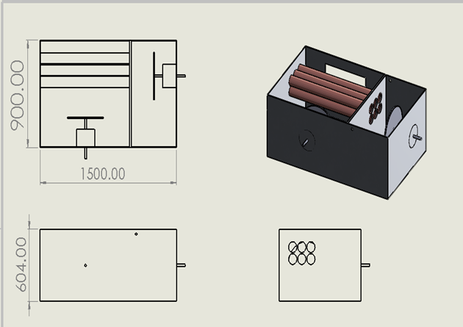
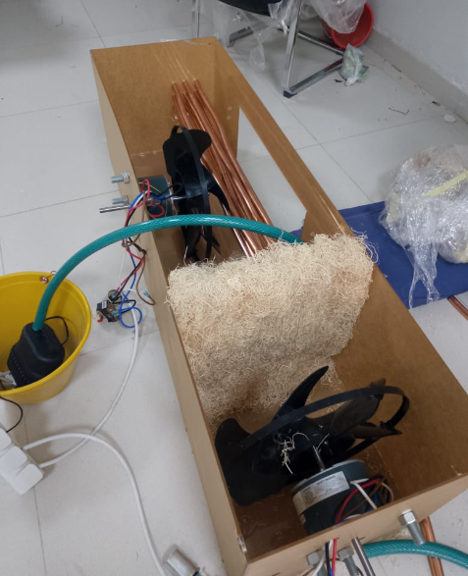
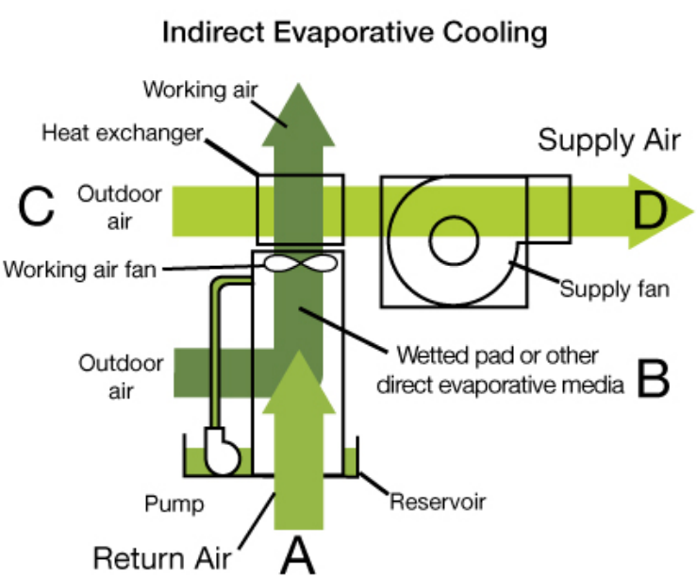
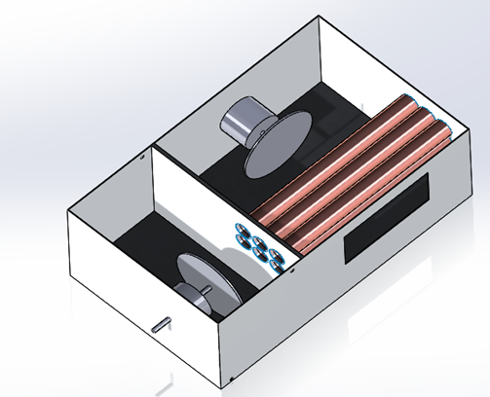
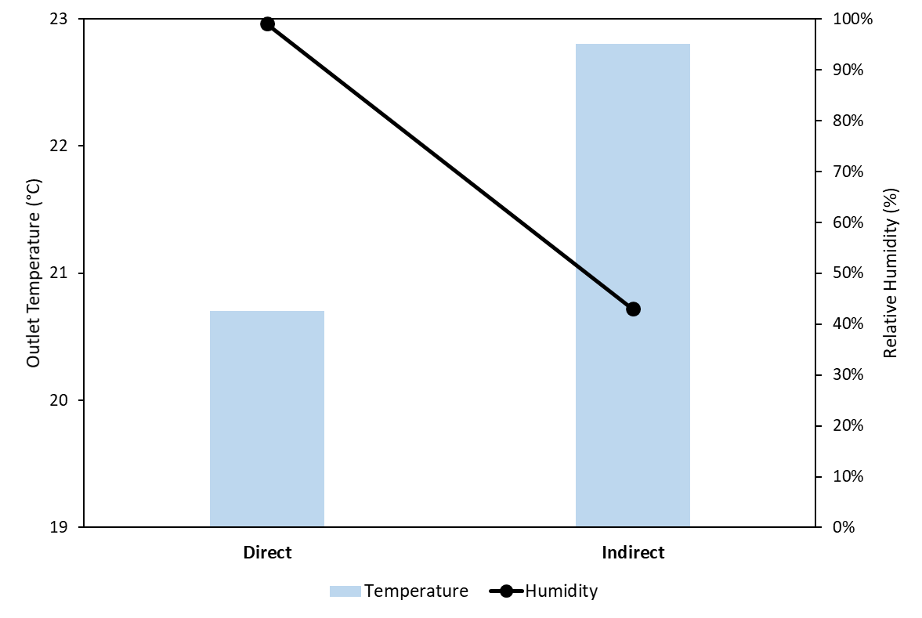
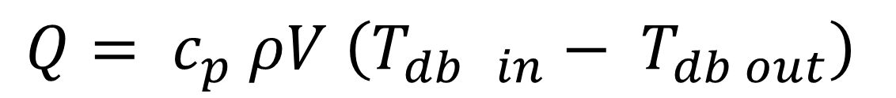
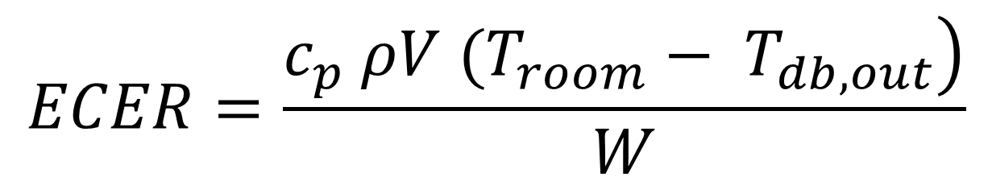
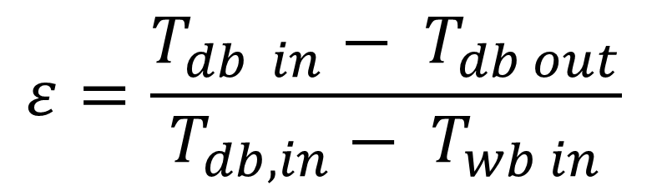
Prince Sattam bin Abdulaziz University
College of Engineering
Mechanical Engineering Department
Design and Fabrication of Indirect Evaporative Cooler (IEC)
Students: Mohamad Hasan Qosadi
Supervisors: Dr. Sulaiman Almoatham
2nd Semester 1445 / 2023-2024 GP 2
Objective
Fabrication of indirect evaporative cooler.
Test the performance of indirect evaporative cooler.
Compare the performance with direct evaporative cooler.
Background and Significance
Residential buildings are consuming 20% of global energy. Space heating and cooling application account for 56% of this energy consumed in buildings.
Improvement of living standards creates a need for cooling.
Conventional vapor compression devices are popular.
Evaporative coolers has a significant energy saving potential.
Evaporative coolers use water instead of refrigerants and remove heat efficiently through evaporation process.
Mathematical model
$$ε=\frac{T_{db in}− T_{db out}}{T_{db,in}− T_{wb in}}$$
Design
Evaporative coolers are classified into direct evaporative and indirect evaporative coolers.
$$ECER=\frac{\left.c_{p} ρV (T_{room}− T_{db,out}\right)}{W}$$
$$Q= c_{p} ρV \left(T_{db in}− T_{db out}\right)$$
Results
The IEC was able to mitigate the increase in the relative humidity of the supply temperature.
Achieved 44% RH instead of 99%.
However, IEC produce higher supply temperature.

