Slide 1


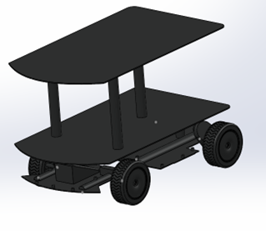
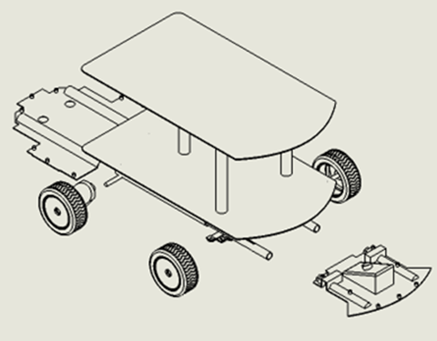
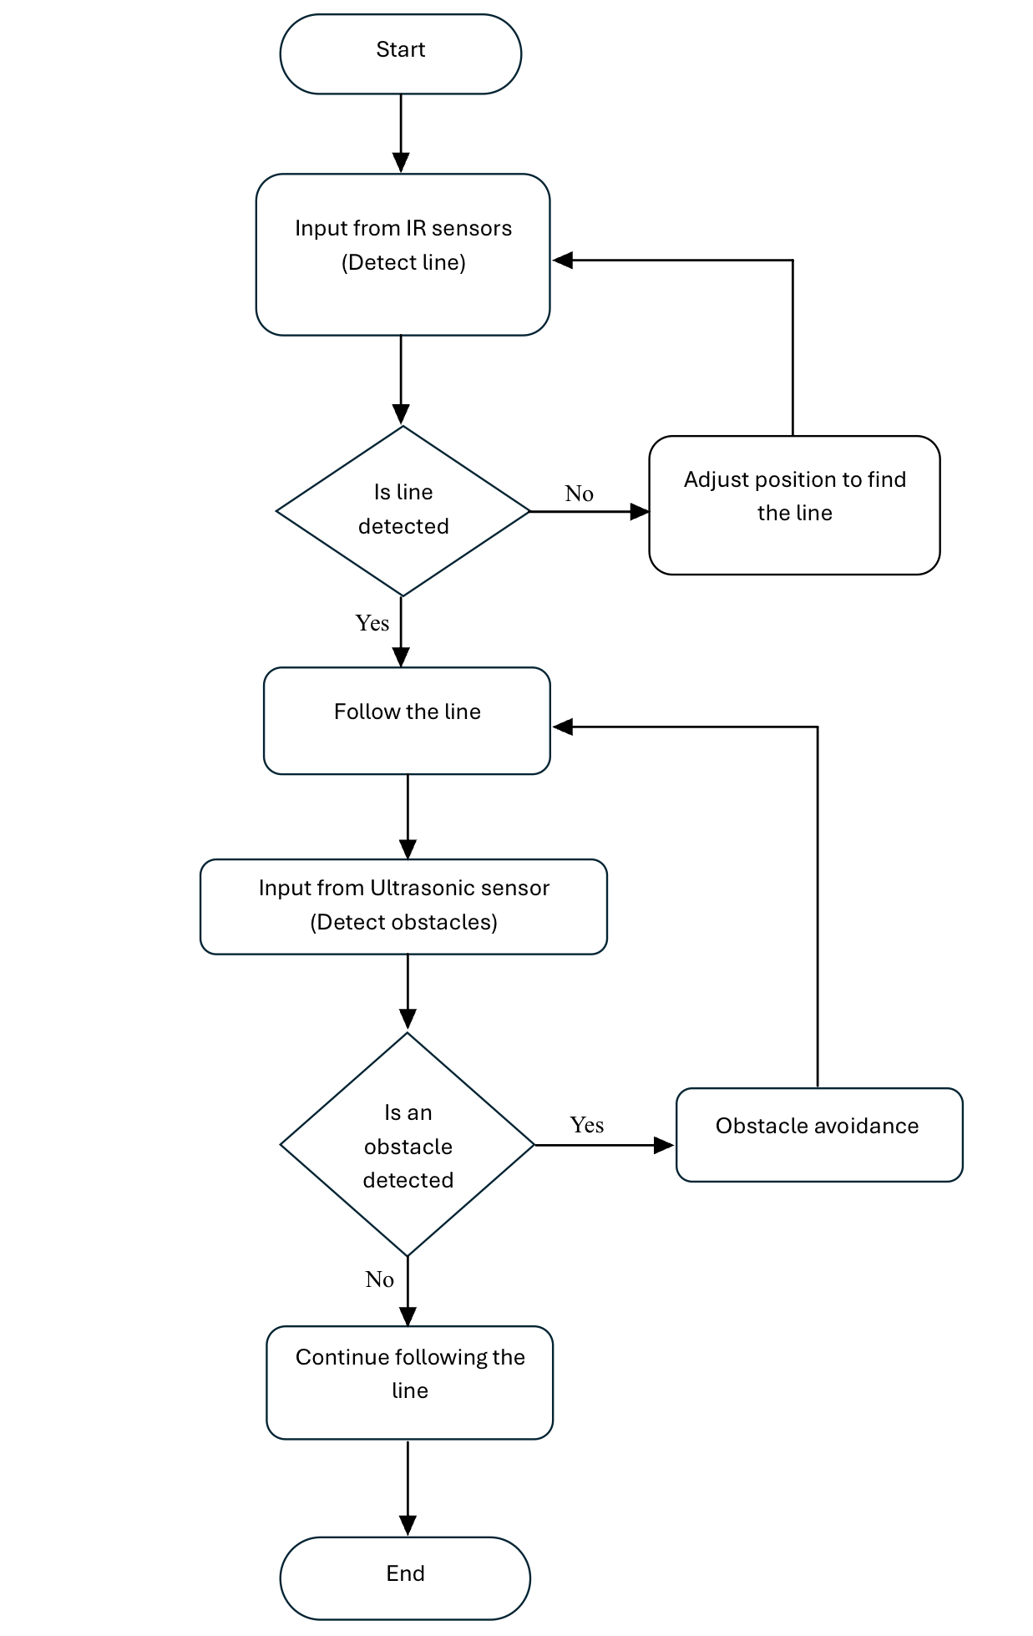
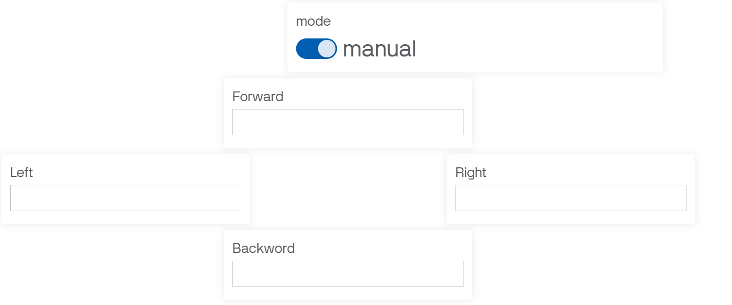
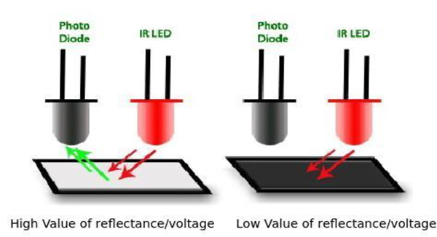
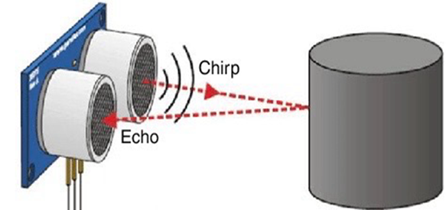
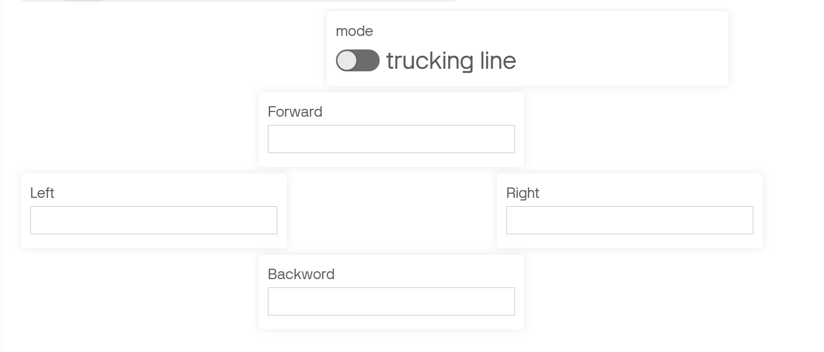
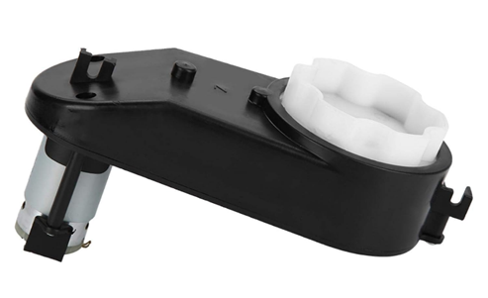
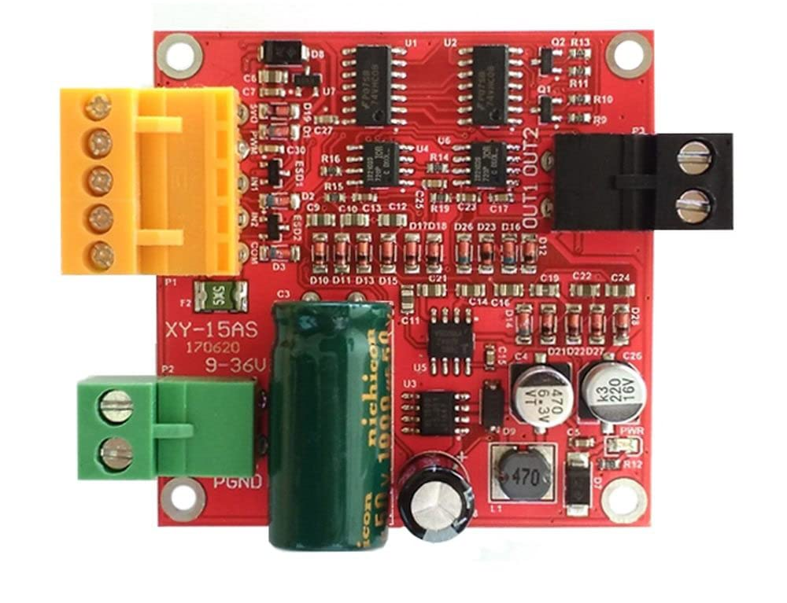
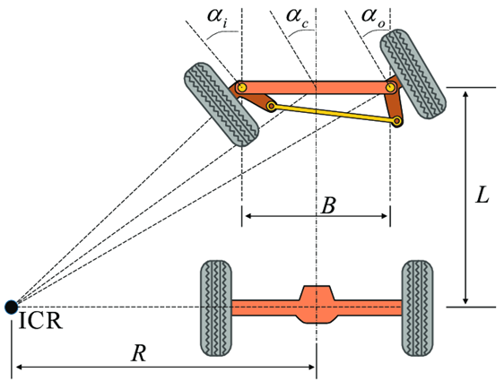
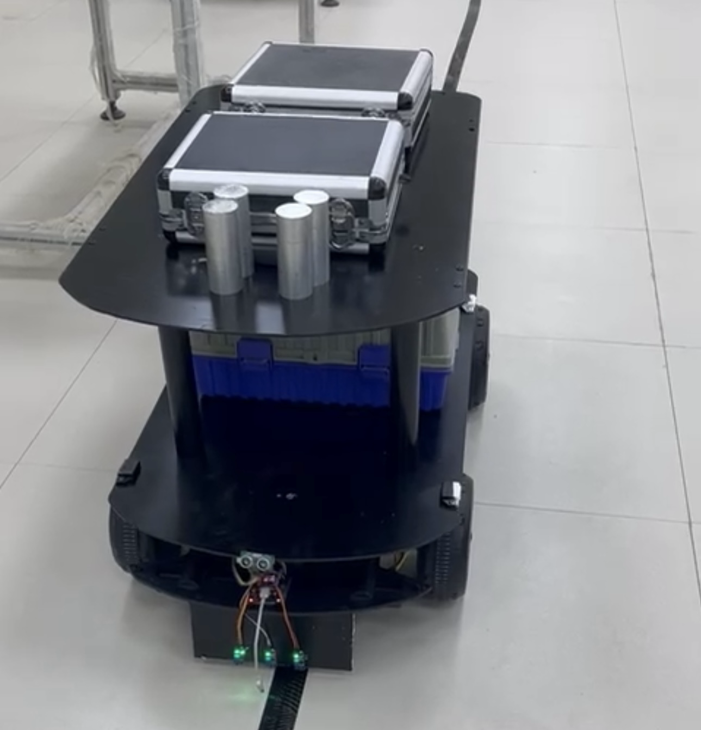
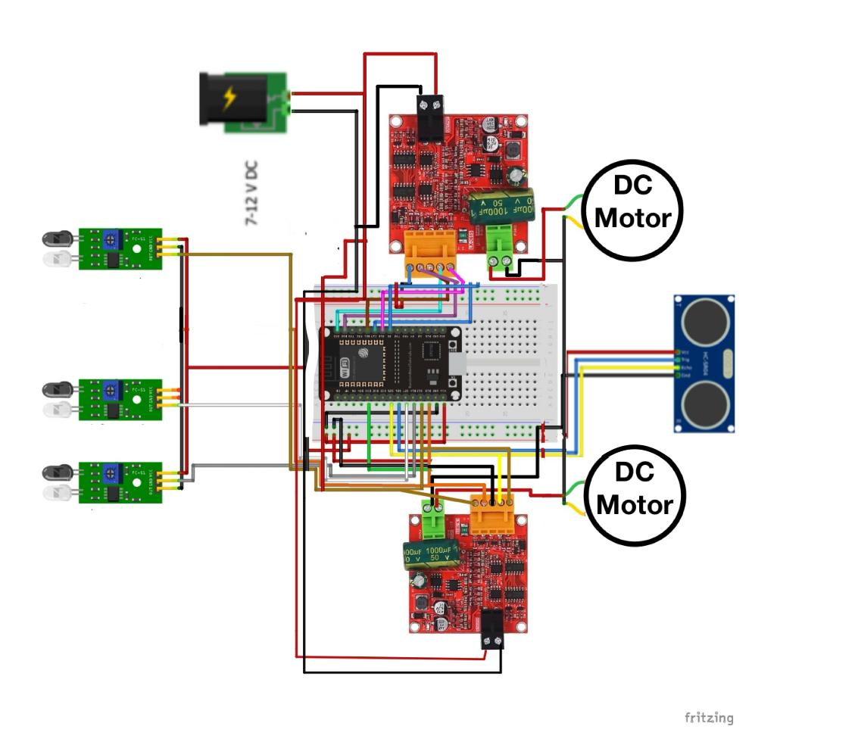
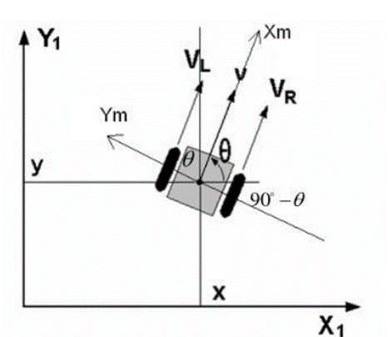
Prince Sattam bin Abdulaziz University
College of Engineering
Industrial Engineering Department
Development of Autonomous Mobile Robots for Industrial Purposes
Students: Alwaleed K. Alqahtani - Ahmed R. Alazani - Abdullah N. Alhuthayli - Abdullah A. Alhuthayli
Supervisor: Dr. Mohammed Rifaee & Dr. Hussein Alrobei
Term 2024 / 2025 Graduation Project (2) Poster ID:
Introduction
Mechanical Design
Robot Programming Ovreview
Mobile robots have become an integral part of modern industry. With their advanced technologies, these robots are capable of autonomous navigation and performing tasks in dynamic and complex environments, supporting automation and enhancing efficiency across various industrial sectors.
Blynk Connection: The code uses the BlynkSimpleEsp32 library for Wi-Fi communication with the Blynk app.
Wi-Fi Settings: Network name and password are defined for connection.
Motor & Sensor Control: Motors are controlled via specific ESP32 pins.
Operating Mode: The robot can switch between manual control via Blynk or automatic line-following mode.
Line Following & Control: In line-following mode, IR sensors guide the robot. In manual mode, the user controls movement via the app.
Obstacle Detection: The ultrasonic sensor stops the robot if an obstacle is detected within 20 cm.
Project Objective
Design Dimensions:
Length: 88 cm , Width: 57 cm ,Height: 58 cm
Our goal is to automate industrial operations such as production lines, inventory management, and manufacturing using mobile robots. This approach aims to improve productivity and efficiency while minimizing human errors and downtime.
Control Systems and Sensors
Sensors:
IR Sensor: Used to follow the line.
Ultrasonic Sensor: Measures the distance to avoid collisions.
Importance of Mobile Robots
Mobile robots significantly enhance industrial processes by automating routine tasks such as material handling, assembly, and inventory management. This reduces human errors and increases productivity, allowing companies to improve the quality of their products and services.
IR Sensor
Ultrasonic Sensor
Actuators:
DC Motors:
DC Motor Driver:
Kinematics of Mobile Robot:
Steering Mechanism:
Ackerman Steering:
Differential Drive:
DC MOTOR
DC DRIVER
Controller:
ESP32: The main controller that receives sensor data and sends control commands.
Circuit design
Conclusion
Our project improves factory and warehouse efficiency by providing a faster, more accurate alternative to conveyor belts and human labor. Mobile robots ensure continuous operation and can be quickly replaced if one fails, minimizing downtime and maintaining seamless production
Saudi Arabia, Prince Sattam bin Abdulaziz University, College of Engineering, Industrial Engineering Department

